Slide 1

2025 Lilly Endowment Community Scholars Program (LECSP)

Slide 2
  Jodi Kateiva
  Scholarship Administrator
  219-736-1880
  jkateiva@legacyfdn.org

Slide 3
  HOUSEKEEPING RULES
  Videos and microphones will be turned off for recording.
  This recording & presentation slides will be available on our website.
  We will use the chat function for questions.
    Please ask general questions for this. If you have
    family specific/personal questions, please email me or call me directly.

Slide 4

Offers scholarships to Lake County students as motivation to graduate high school and attend college.
Serves as a mentor and resource center to ensure nonprofits can effectively provide services to our community.
Assists donors with planning how to invest and manage their charitable assets.
Collaborates with local leaders to solve problems and enhance residents' quality of life.
Provides grants to organizations servicing the Lake County community.

Slide 5
Legacy Foundation’s
Scholarship Program
Two Scholarship Cycles:
Lilly Application Open July 1
Lilly Deadline is September 15
**Universal Application (for 40+ various scholarships)
November 1, 2024 – January 15, 2025

Slide 6
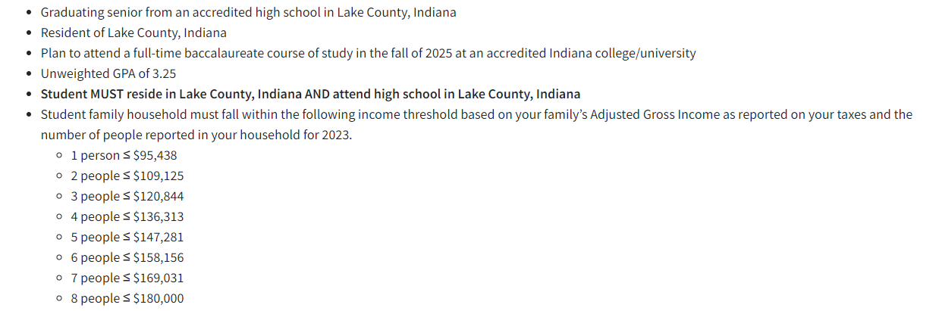
Lilly Endowment Community Scholarship Program (LECSP)
Eligibility Requirements

Slide 7
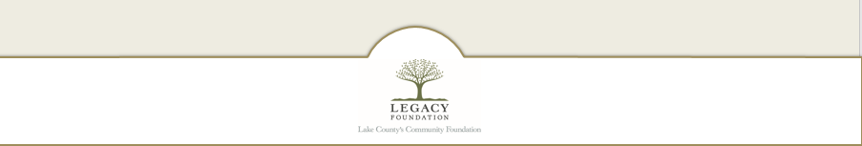
Lilly Endowment Community Scholarship program (LECSP)

Slide 8
What is the LECSP
(aka The Lilly)?
The Lilly Endowment Community Scholarship (LECSP) was established in 1998 to help raise the level of educational attainment in Indiana. LECSP encourages Indiana’s most talented students to attend one of Indiana’s fine colleges or universities and after graduation consider pursuing occupations in Indiana.
Each county in Indiana participates in the LECSP through their local community foundation. Since the program’s inception, Legacy Foundation has been able to award over 200 full tuition scholarships to Lake County students through the LECSP.
Award Details
Six (6) students from Lake county will receive the scholarship.
Covers four (4) years of full tuition to ANY accredited 4-year private or public college in Indiana.
The students will also receive a $900 per year stipend for books.
This is NOT a FULL RIDE scholarship. Room & board is NOT covered although most students receive other scholarship awards from their institution to cover at least part of these expenses.

Slide 9

Lilly Eligibility Criteria
Must be resident of Lake County
Must be graduating senior from an accredited school in Lake County
3.25 GPA (unweighted) cumulative through Junior year
Meet Financial Eligibility requirements
Citizenship is NOT required
Selection Criteria
academics
demonstrated leadership skills
service to others
character
essay
interview

Slide 10
Process & Timeline
September 15, 2024 at 5pm: Deadline to apply
September 18, 2024: Each school will receive all the completed applications from their school. School Administrators will be reviewing these applications to determine the school’s one Finalist.
October 4, 2024: Legacy will notify students of if they are selected as their school’s finalist to move along in the process.
October 9, 2024: Finalists will need to turn in their Financial Verification Documents. This is ONLY if you are selected by your school to be a finalist.
October 21, 2024: Finalists will be notified if they will be interviewed. 16-18 finalists will be interviewed.
October 29 - 30, 2024: Student Interviews
Mid-December: Recipients announced.
There are 6 recipients and 4 alternates. These must be approved by the Lilly Endowment.
6 additional scholarships will be awarded through this process; they range from $10,000 ($2,500 renewable) to $1,000.

Slide 11

How to apply?
Application is available on our website.
https://legacyfdn.org/

Slide 12
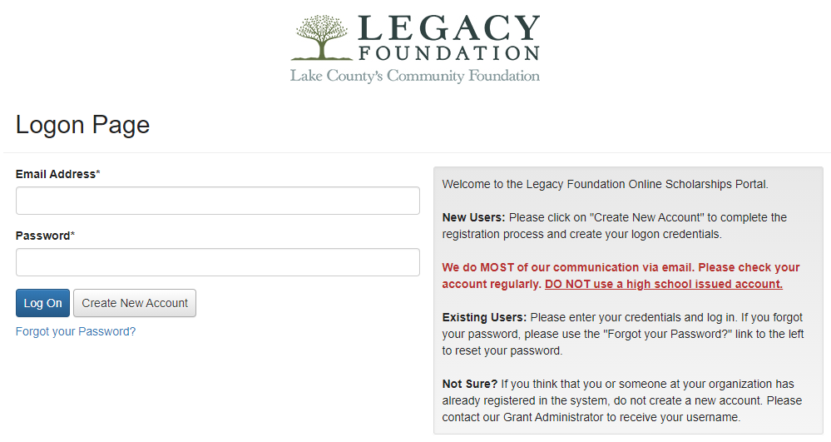
Log In Page
www.grantinterface.com/Home/Logon?urlkey=lfs
DO NOT
use a high school- issued email account!
Students will need to create a new account.
If you forget your password; click here. Check your junk mail if you don’t get something from Foundant. Email Legacy if you are still unable to reset password.

Slide 13
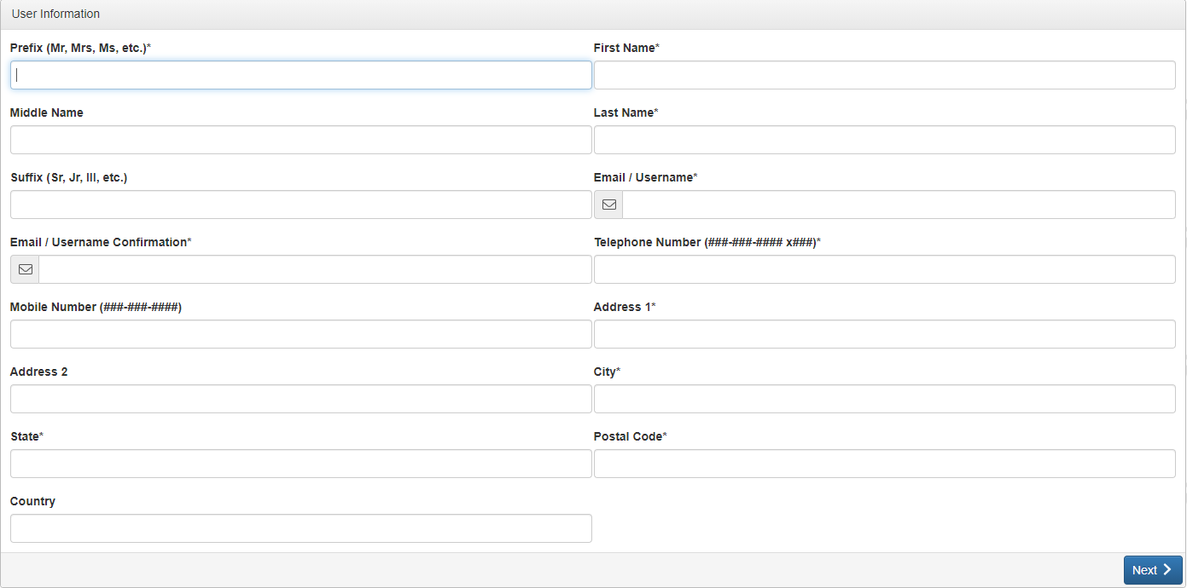
Creating Your Profile
Please note - this is the information that will be attached to your future applications. Make sure things are spelled & capitalized correctly.
This application should be completed by STUDENTS – NOT PARENTS!

Slide 14
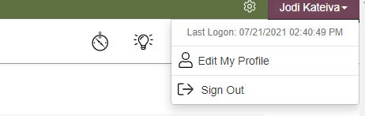
Updating Your Profile
To change / update information on your profile:
Click Your Name in top right corner
Click Edit My Profile
Please make sure this includes the most current contact information for you.

Slide 15
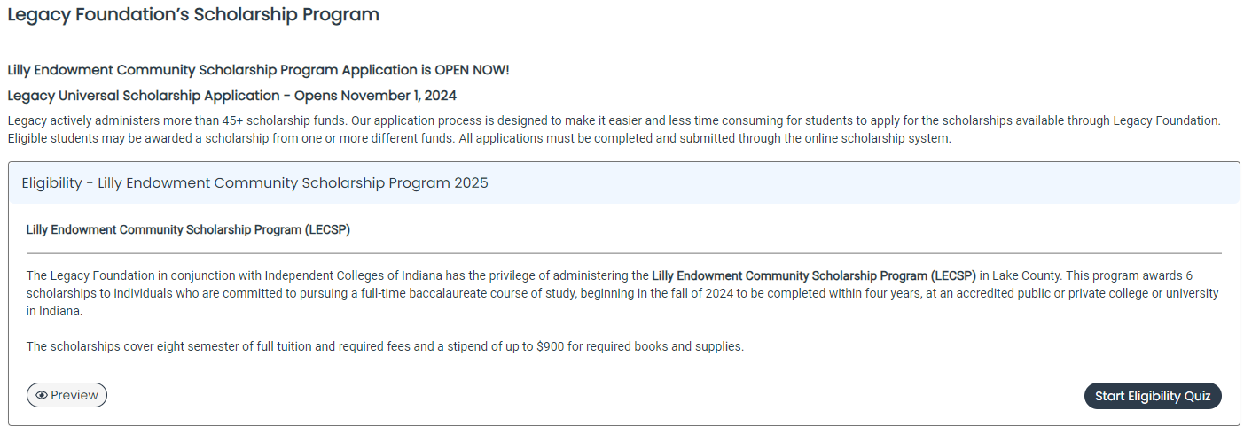
Student Apply Page

Slide 16
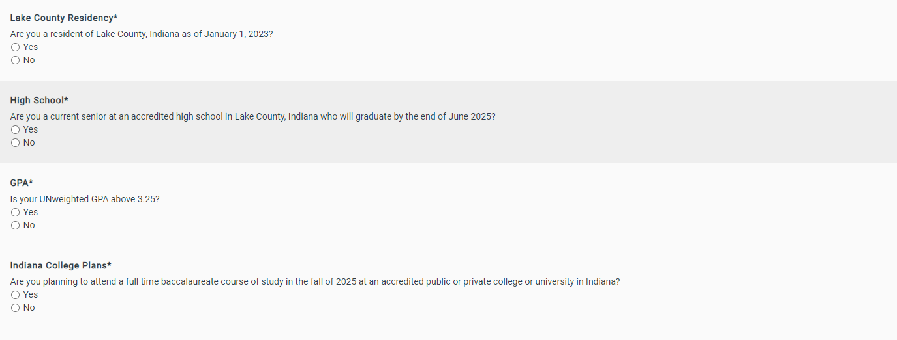
You will first need to complete the Eligibility Quiz

Slide 17
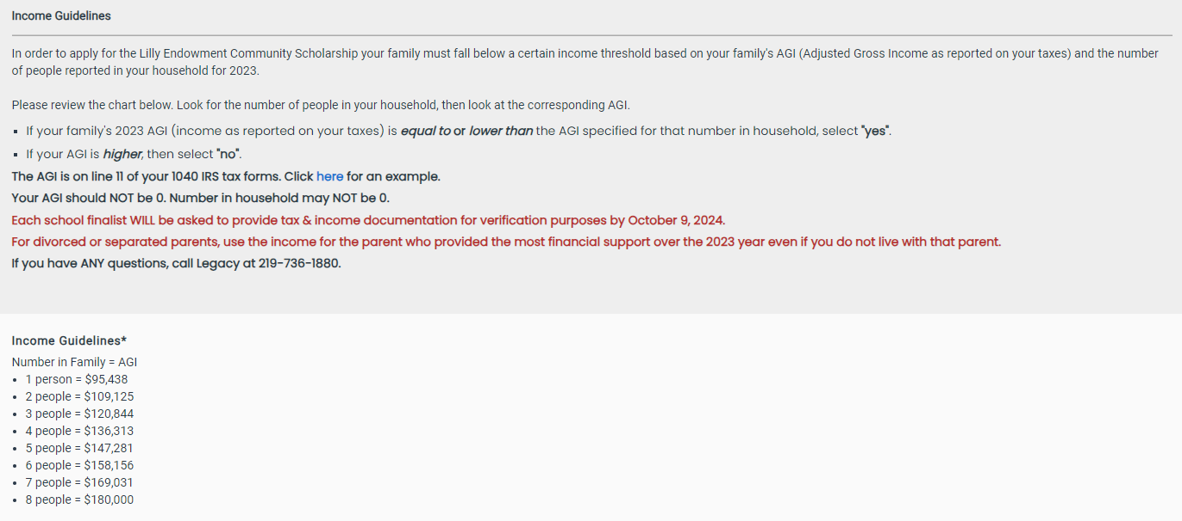
Eligibility Quiz: Financial Requirements
Student’s family must be considered 150% of median income as defined by HUD to apply.
To apply your family must fall below a certain income threshold based on your family's AGI (Adjusted Gross Income)
and the number of people reported in your household for 2023.
You WILL NEED to verify this information with a parent or guardian BEFORE applying.
School Finalists will be asked to provide verification of their financial eligibility via tax returns or alternate documentation.

Slide 18
Financial Information Flowchart:
Which parent’s financial information do I use?
Are your parents married to each other?
  If yes, provide information about both parents (even if they file taxes separately)
  If no, go to the next question.
Do your parents live together?
  If yes, provide information about both parents.
  If no, go to the next question.
Did one parent provide more financial support than the other over the past 12 months?
  If yes, use the parent that provided the most financial support.
  If the parents provided the exact equal amount of financial support, select the parent that has the greater income or assets.
Has a Parent you identified in the previous question remarried.
  If yes, you must provide information for both the parent and the stepparent.
  If they are not remarried, provide information for just this parent.
What if I am emancipated or a ward of the state?
  You would use your sole income (if any)

Slide 19
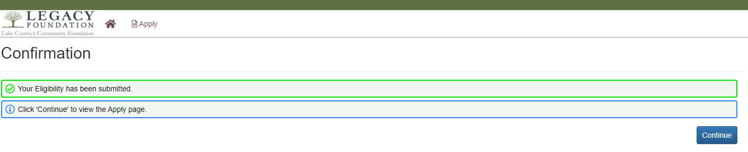
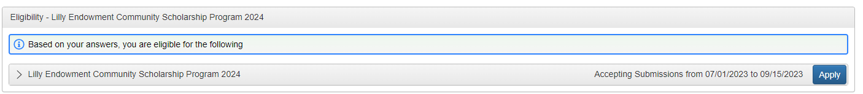
If you are eligible, click the “Apply” button to access application.
If you are not eligible and have questions, please reach out.

Slide 20
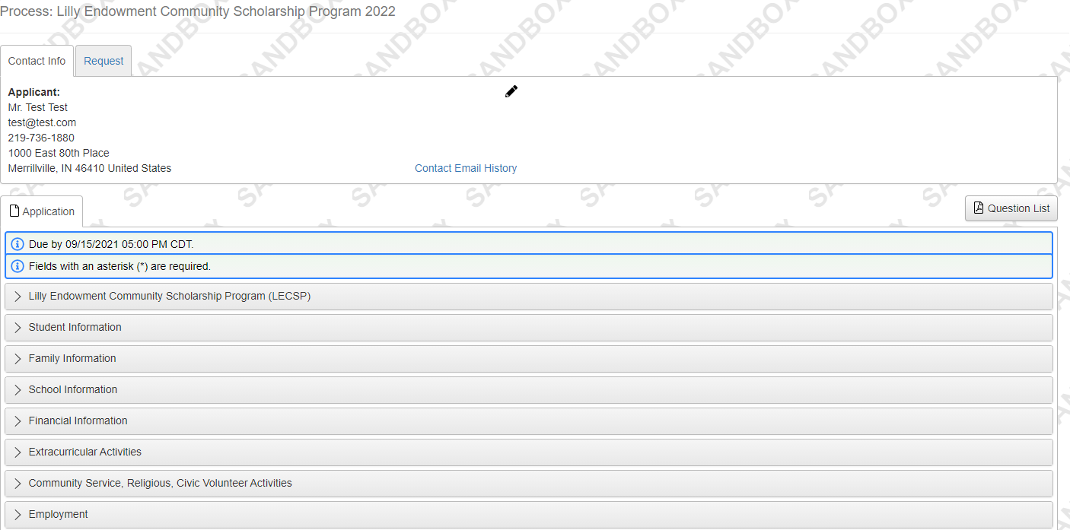
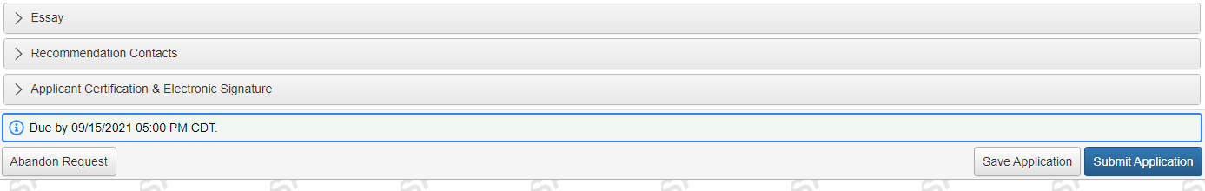

Student View: Application
You can download a PDF
of the application.
Students can expand/close each of the sections.
If you decide NOT to apply, you can abandon your request. If you do this, you will no longer receive reminder emails & texts about your application and you will not have access to your application.

Slide 21
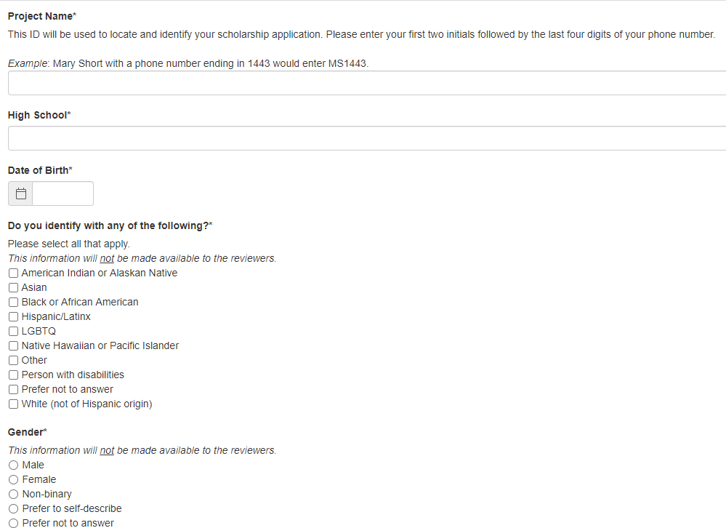
Student View: Student Information
We ask these questions for tracking purposes only.
We want to ensure that we are reaching a diverse community of students reflective of Lake County.

Slide 22
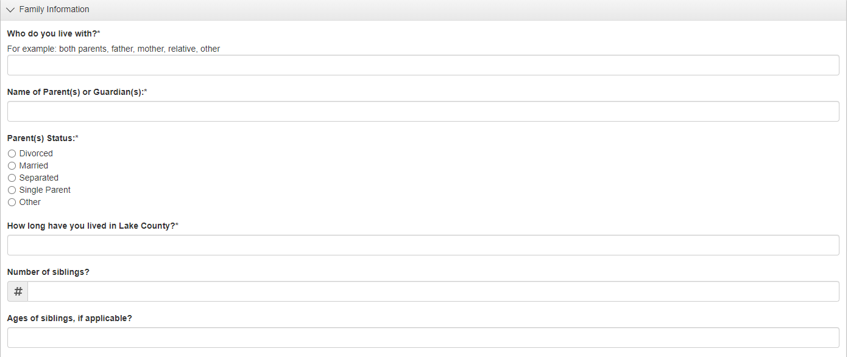
Student View: Family Information

Slide 23
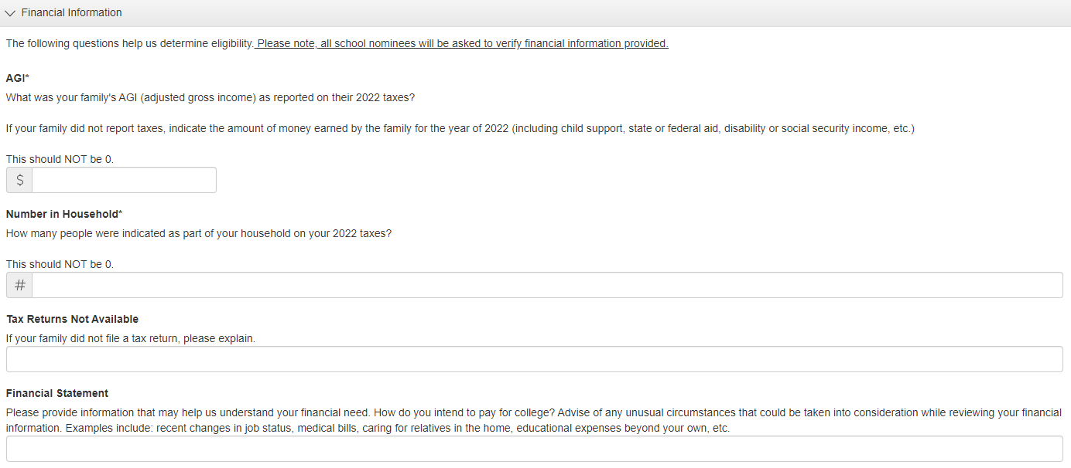
Student View: Financial Information

Slide 24
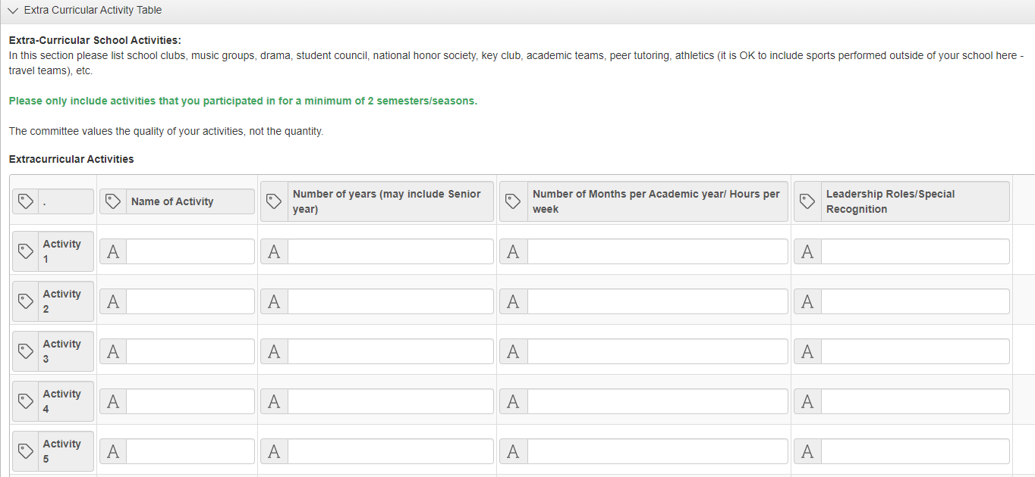
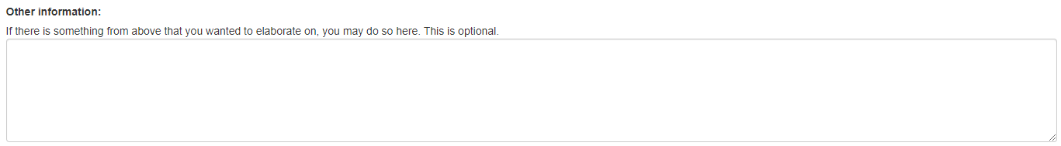
Student View: Extra Curricular Activities

Slide 25
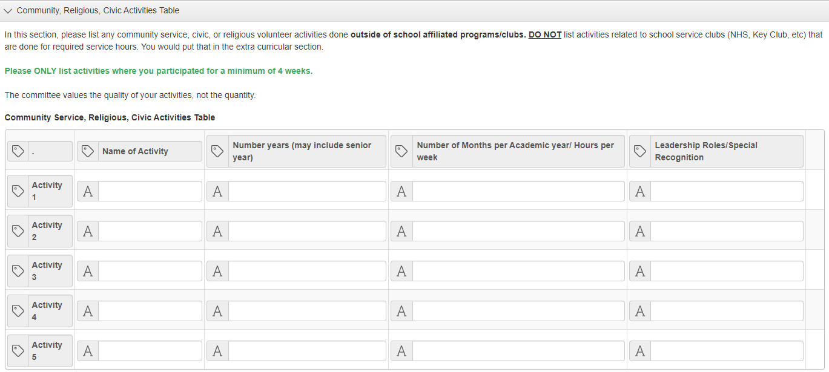
Student View: Community, Religious, Civic Activities
Key Points:
Follow the example format.
DO NOT list activities related to school service clubs (NHS, Key Club, etc.) that are done for required service hours. You would put that in the extra curricular section.
Please ONLY list activities where you participated for a minimum of 4 weeks.

Slide 26
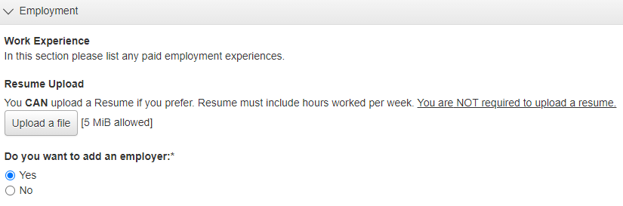
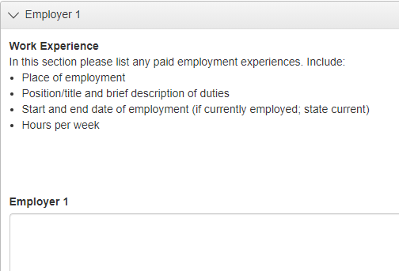
Student View: Employment History
Key Points:
You can upload a resume instead of typing in each employer. If you chose this option, make sure it contains the necessary information like hours worked per week.
It is NOT required that you upload a resume. We do NOT want you to create one just for this process. This is a timesaver for those of you that have them!

Slide 27
Student View: Essay
You will need to complete 3 essays.
Each essay is limited to 2,500 characters or 250-400 words.
We recommend saving them in another format and copying them into the essay boxes.
Essay 1 - Mandatory
Explain your future educational and professional goals. Why have you chosen this? How might these goals contribute to improving the quality of life in Northwest Indiana?
Essay 2 - Mandatory
How have you taken advantage of networks or opportunities in your school, work or community to enhance your learning journey and cultivate your leadership potential?
Essay 3 - Pick one (1) of the following prompts
Discuss an accomplishment, event, challenge, or realization that sparked a period of personal growth and a new understanding of yourself or others.
Please write a short autobiography including information about your family, hobbies, spare time activities and what inspires you. You may elaborate on work, community or school activities you didn't get to address in your application.

Slide 28
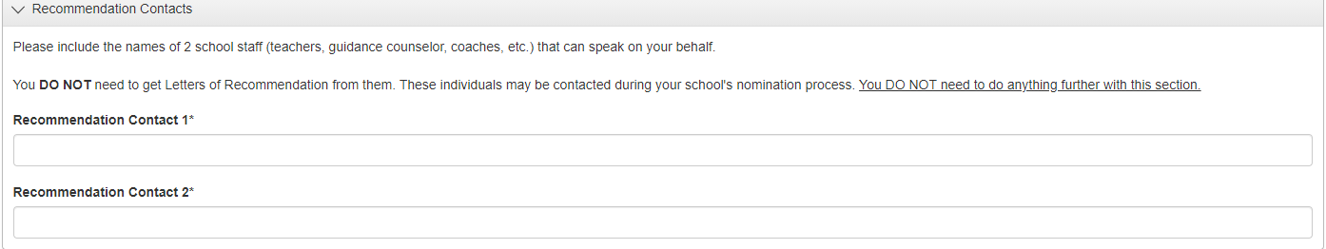
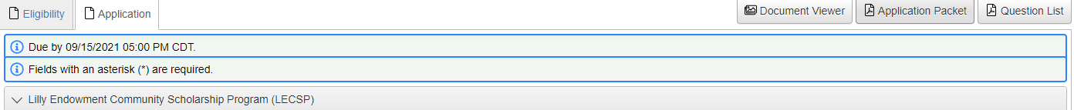
Student View: Recommendation Contacts
Students DO NOT need to get Recommendation Letters for this application.
This section allows the student to name 2 contacts that the school can use to gather information when selecting their nominee.
Review BEFORE you submit.
You can download a PDF of your application
by clicking “Application Packet” on your dashboard.

Slide 29
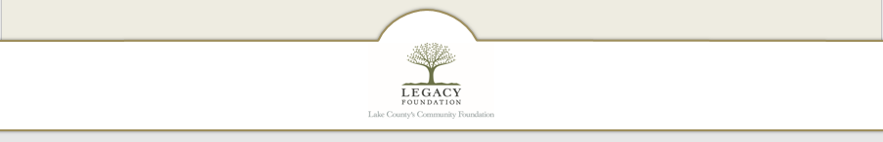
Scholarship Tips
Brag about yourself!
Take time to write down all of your activities, goals, what sets you apart. This can be used for college applications & all of the scholarships you will apply for.
Capitalization & spelling counts.
Print it and read it aloud before you submit. This will help you hear errors that you don’t always see.
Make sure uploaded documents are correct.
Find a reviewer. They catch things you might miss.
Take your time.
Do not wait until the last minute to complete or submit! Computers have glitches.
Don’t let a computer issue ruin your day- or your chances of getting this awesome scholarship!
The DEADLINE is 5pm. Not 5:02, 5:05 or 5:10.

Slide 30


Slide 31


Questions?

