Slide 1
Grant Making Priorities and Strategy

Slide 2
Community Foundations have a broad mandate to serve communities;
usually among multiple fields of interest with a defined geographic focus.
Anticipate Community Needs
Active Leadership
Respond Quickly to Socio-economic Trends
Community Foundations

Slide 3
Legacy Foundation seeks to support organizations that make Lake County a better place to live.
Enhance the effectiveness of non-profit organizations through:
Capability improvement
Knowledge
Resources
Strengthen and empower non-profits, neighborhoods, and individuals to collectively participate in community transformation efforts.

Slide 4
For more than 30 years, Legacy Foundation's grants have invested in strengthening the social fabric of our communities. In 2023, Transform Lake County Grants will continue to support our communities with a sharpened focus on the most pressing challenges our community is facing today: systemic racism and racial injustice, and the underinvestment and lack of infrastructure in under-resourced and marginalized communities across Lake County. This funding opportunity recognizes that deeply entrenched inequities mean that our current challenges – and resulting traumas – are disproportionately impacting some populations and communities.

Slide 5
Legacy Grants Values and Commitments
We are committed to funding across Lake County with grant dollars reaching our rural, suburban and urban communities.
We give high priority to investments that are strengths-based and create positive, substantive change that addresses issues at their root cause.
We prioritize investments that demonstrate strong community support, solid planning and wise stewardship.
We believe that impactful, creative and sustainable solutions come from people closest to the issues being addressed and implemented by organizations trusted by the community.

Slide 6
Priority Areas
Organizations with a budget under $2 million
The proposed request aims to address the issue at its source (root cause)
Organizations that have not received consecutive grants from Legacy Foundation in recent years
Innovative and new ideas
Proposals that will help to improve services or eliminate duplication
Proposals that help implement an organization’s strategic plan
Proposals that are community driven or include community outreach and involvement
Proposals that have a financial match or that can use Legacy funding to leverage additional resources
Proposals that incorporate IDEA (inclusion, diversity, equity, and accessibility)
Resident Leadership Development

Slide 7
Grant Application Review Components
Applications must be able to demonstrate:
The organization has the capacity to carry out the proposed work
Project is clearly defined with timeline and action steps
Funding from Legacy will be impactful
Budget is clearly defined and costs are reasonable
Clear and achievable outcomes
Project is sustainable without requiring ongoing Legacy funding in future years
Necessary collaborations have been established and formalized with attached documentation

Slide 8
Proposal Evaluation
Tie your goals directly to your need statement.
Include all relevant groups and individuals in your target population.
Always allow plenty of time to accomplish the goals.
Figure out how you will measure the change projected in each goal. If there is no way to measure an objective, it needs to be altered or dropped.
Goals should be SMART (specific, measurable, attainable, relevant, and time-bound)

Slide 9
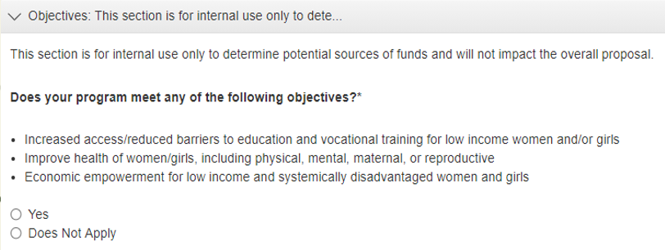
Multiple Funding Sources
Legacy had a number of funds that can be used to support projects. This internal question has no weight on your application. It is simply used to alert staff and reviewers consider a particular funding source when evaluating the proposal.
Transform Lake County
(Lake County Community Fund)
Women in Philanthropy
US Steel/City of Gary Charitable Fund
Based on the grant cycle, you may find more/less objective based questions in this section. Again, answering yes/no does NOT affect the outcome of your proposal.

Slide 10
Transforming Lake County by providing strategic leadership and impactful philanthropic support to ensure equitable opportunity for all communities that we serve.
Transform Lake County (TLC)
Application Open Date | Application Due Date | Notification Date
March 1 | April 1 | Mid May
September 1 | October 1 | Mid November
U.S.
Steel/City of Gary Charitable Fund
Increased
top
award!
Thriving Hobart Seniors (T
Grants range from $2,000-$35,000
Applications accepted September 1- October1
Women
in Philanthropy
Grantees must be from organizations that primarily serve women and/or girls
Grants range from $2,000-$15,000
Applications accepted in both the spring and fall cycles

Slide 11
To increase attract and retain talent, increase opportunity, and promote civic and community engagement in Gary
Gary Knight Foundation Grants
Application Open Date | Application Due Date | Notification Date
TBD | TBD | TBD
To offer opportunities for residents of Lake County to engage in and participate in events that will increase community involvement and education
Sponsorships
Application Open Date | Application Due Date | Notification Date
Now!* | Rolling (6 weeks to event) | Rolling
*Subject to COVID-19 Numbers in Lake County

Slide 12
Review Process:
Staff review applications to verify qualification.
The Grants Committee and Board of Directors review and vote on all funding decisions. The awards granted can range from $2,000 -$35,000.
Funding decisions are communicated to applicants via email approximately 6 weeks after application due date.

Slide 13
What We Do Not Fund
For-profit businesses and organizations
Individuals
Scholarships to colleges/universities (see our Scholarships)
A proposal that promotes a particular religion, political affiliation, or lobbying
A proposal that discriminates based on age, race, ethnicity, gender, sexual orientation
Post expenditure requests or debt
Fundraisers
Capital Campaigns
Publications, film, or media produced for resale for a profit

Slide 14
Legacy does not fund Public, Private, or Charter K-12 Schools,
or Private Academies
However, Legacy will fund non-profit groups and partnerships
proposing to conduct programs in partnership with schools.
Partnerships between non-profit groups and schools is most
preferred when the partnership will benefit multiple schools.
Partnerships between non-profit groups and schools are preferred when the broader community can also benefit from the goals.

Slide 15
Grant Requests:
Pre-application meeting with Legacy staff is strongly recommended, especially if your organization has not previously received a Legacy grant.
Only one grant from each category (TLC/Sponsorship/US Steel) can be awarded in a 12-month period.
Final reports must be submitted and approved before future grants can be awarded
Organizations are able to apply for other opportunities that might arise during the year.

Slide 16
Top 10 Grant Writing Mistakes
Not following instructions/guidelines
Not answering the questions asked
Purpose of grant is not clear
Grammar and typos
Jargon and catchphrases
Unclear budget
Objectives do not match the problem
Necessary collaborations have not been established
Organization lacks capacity to carry out proposed activities
Additional funding has not been secured

Slide 17
Application Process in GLM

Slide 18
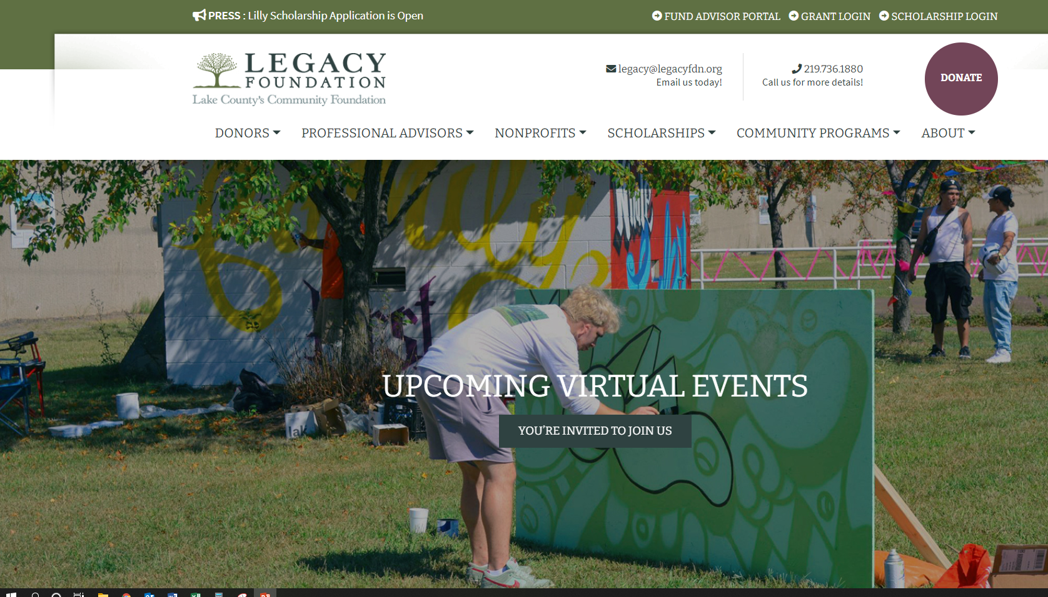
Logging Into the System

Slide 19
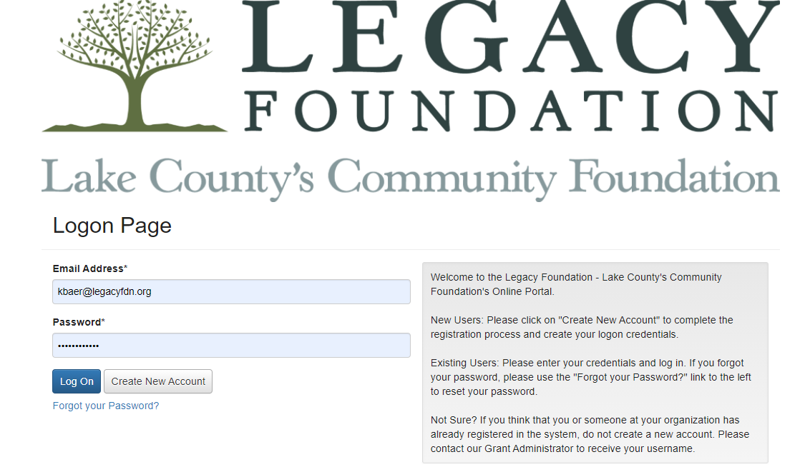
First time in the system? Click Create New Account
Returning to your application? Log On with your email and password.

Slide 20
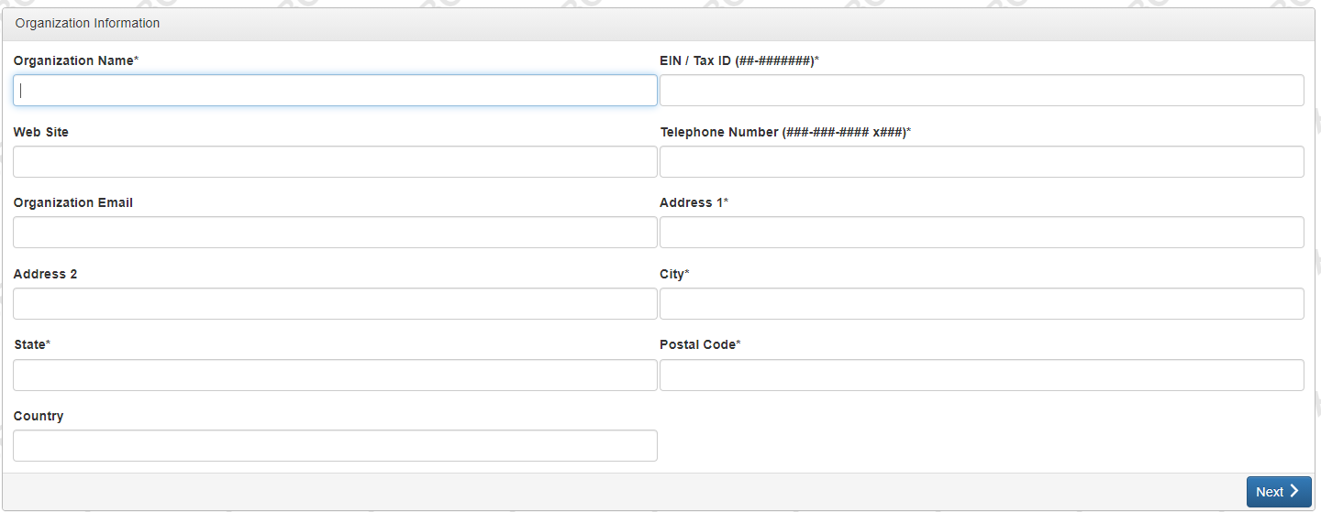
Organizational Information
*If the EIN number is already associated with an account, you will receive a notice to contact the office before proceeding.
ALL information entered as a part of the account creation process becomes part of your submitted application! Assure that all information is entered correctly.

Slide 21
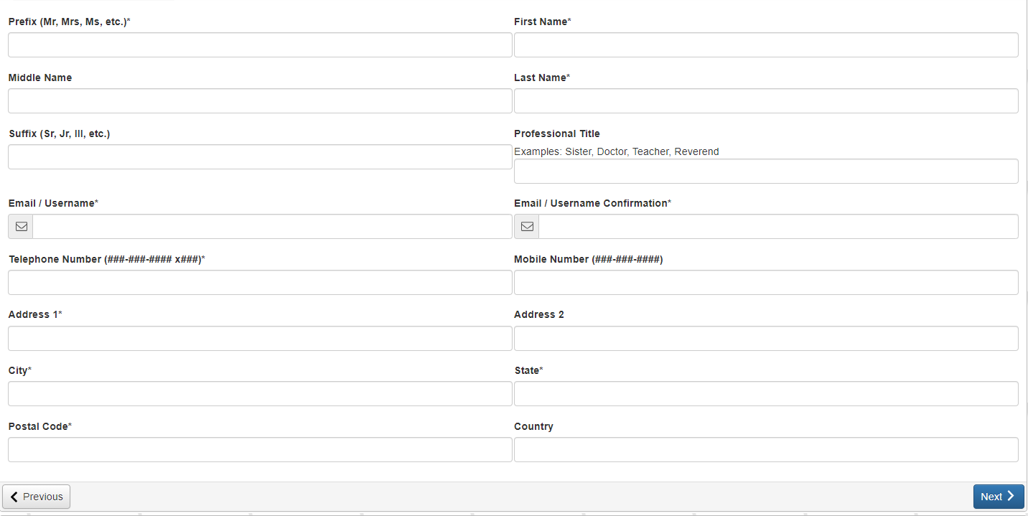
Entering Contact Information

Slide 22
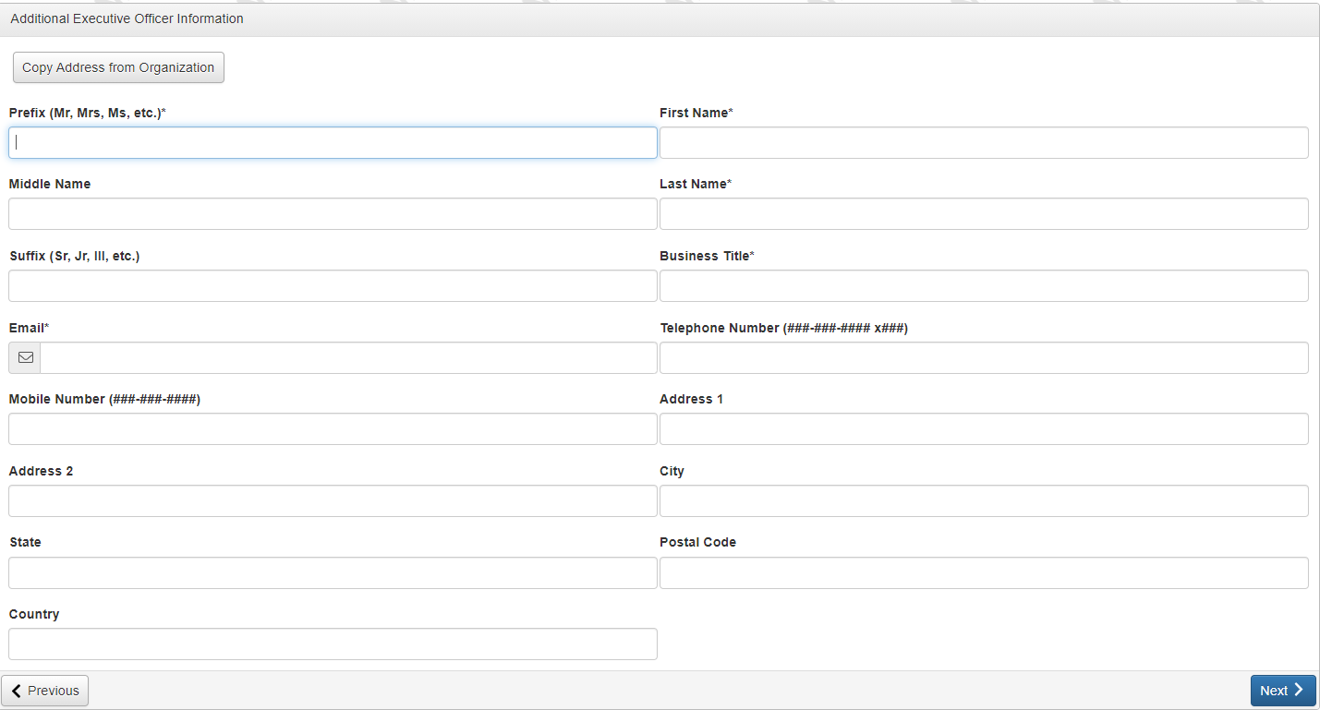
Was the contact information listed on the previous screen for the ED?
Yes → Next
Enter any additional information for the ED → Next
No, then enter the information for the ED → Next

Slide 23
Create a password – note the password requirements
This system sends automated email communications to you during the application process and follow up reminders once awarded. It is important that you are able to receive these communications. After creating a password, you will have the opportunity to verify that the emails are coming through.

Slide 24
Access Codes
We have the ability to email access codes to individual organizations that fit criteria for a specific grant. If invited to apply, you will receive an email containing the code.
Log into your account
You WILL NOT see the application listed in the Apply section
Type your access code in the box at the top of the screen
Click “Enter Code” and the application will open for you to begin

Slide 25
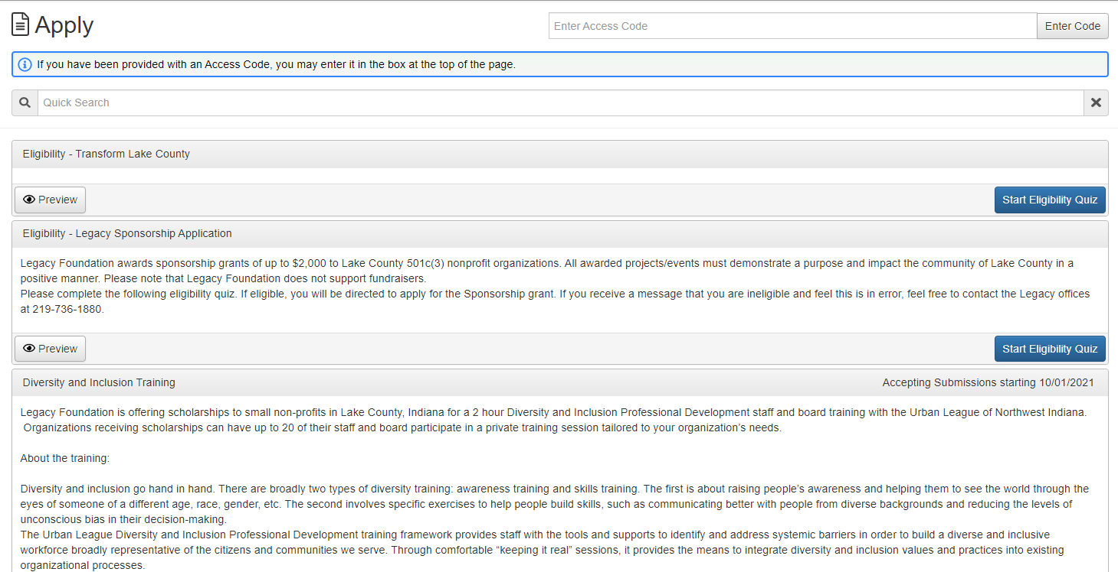
After creating the account, you will be directed to a list of grant opportunities currently available.
This is to preview the eligibility quiz, NOT the application.
To begin the application, click to Start Eligibility Quiz

Slide 26
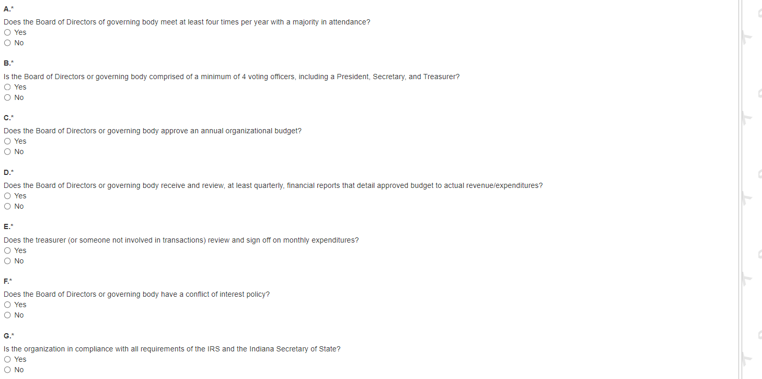
Answer Prequalifying Questions to Begin

Slide 27
Eligibility Results
After qualifying, you will be directed to this confirmation page. If there were multiple grant opportunities available based on your answers, they would appear here. Click Continue.
Clicking Continue (above) directs you back to the Dashboard where you will click to Apply.

Slide 28
Ineligible
If you do not qualify, you will see the message below. If you feel this is an error, please contact our office. Kelly B. will review your answers and, if appropriate, re-open the quiz.

Slide 29
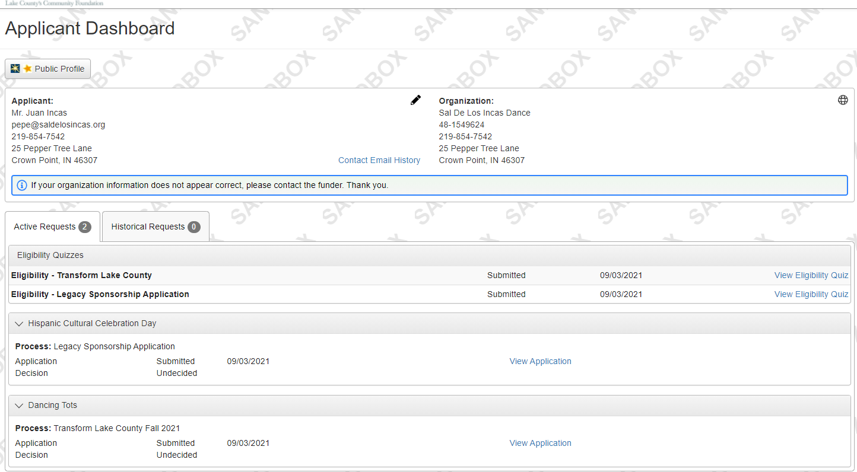
Editing Your Profile
As the contact information is a part of your application, it is important that you update any changes to address, email, etc.
Log into your account
Click on the pencil icon on your Applicant Dashboard page to edit you APPLICANT information
To edit your ORGANIZATION information, please contact Kelly B. at 219-736-1880

Slide 30
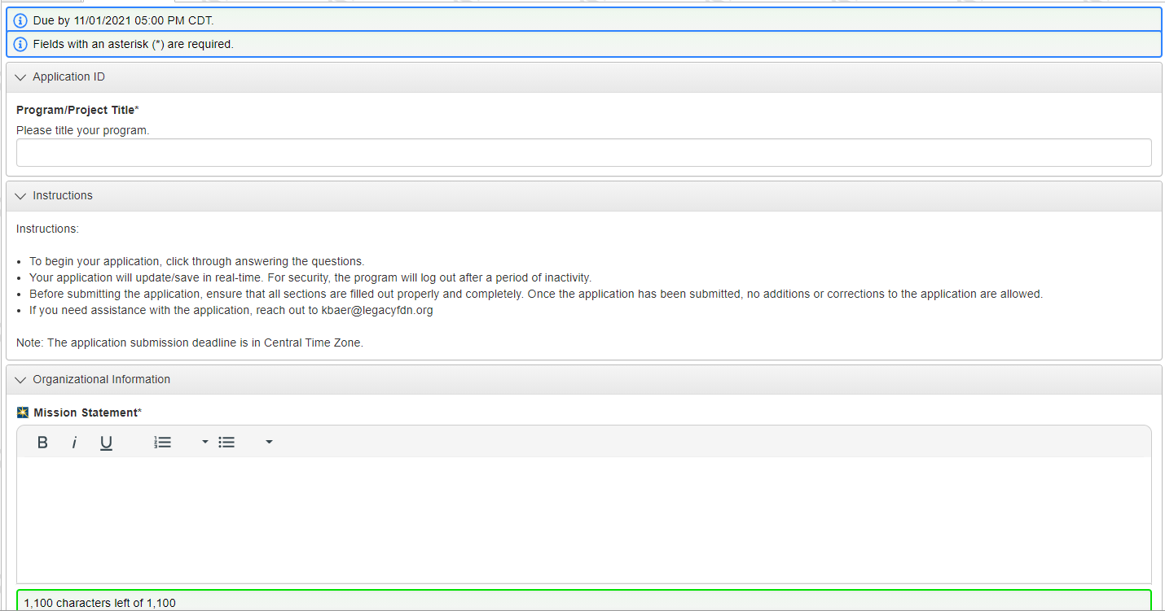
Let’s Get Started
Note the Due Date/Time!
This title will copy over to all components of the application including post acceptance forms that we ask you to complete.
The new software has GuideStar enabled questions. Using your organization’s EIN number, you can import answers directly from GuideStar when you see this icon:

Slide 31
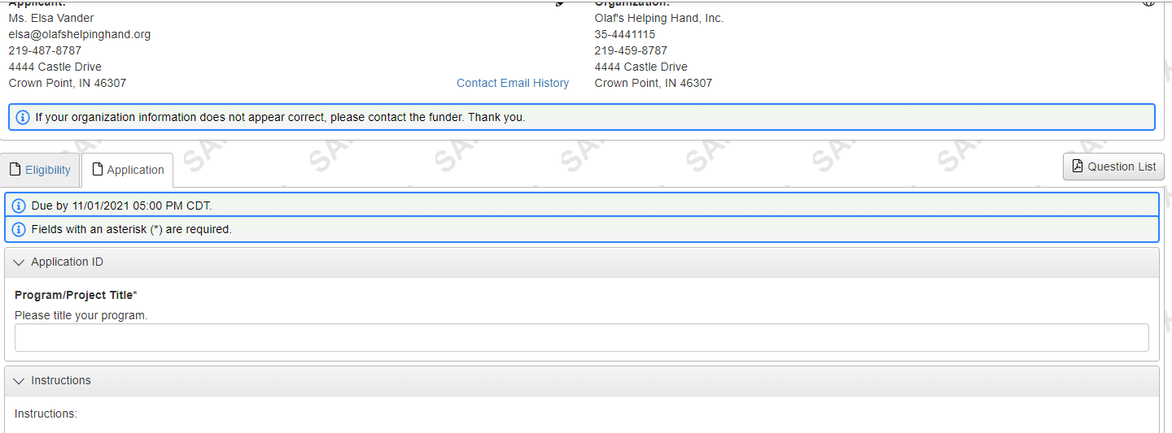
Need a Printed Copy of the Application?
Just looking to print a list of the questions you’ll need to answer?
After logging in to the application, click on Question List
Need a copy that includes your answers?
Pull up your application and right click on the screen. You can save or print a copy of the application with answers.

Slide 32
Import Feature for Future Grants
Have you previously applied for a grant? If so, click on the Copy Previous Answers button for potential time saving assistance.
You will find this button on the same screen that you complete the application.
Determine if it makes sense to import answers from a previous grant. Note the Matching Answers column.

Slide 33
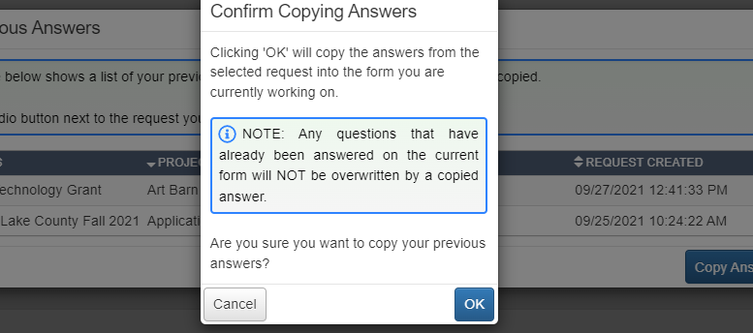
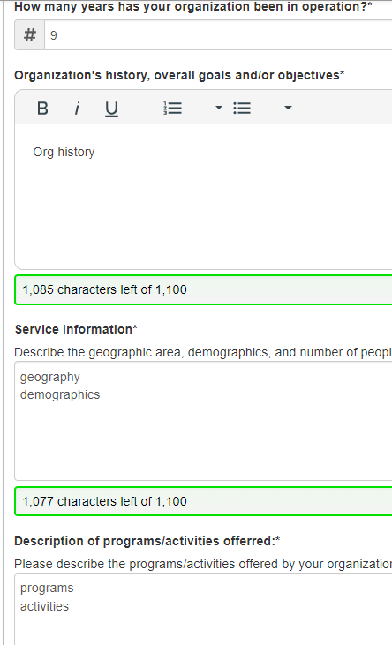
Note: answers will only be uploaded for BLANK questions. Nothing will be overwritten.
Click OK to proceed
The answers have now been imported.
REVIEW YOUR ANSWERS! Make sure details have been updated to reflect the current proposal.

Slide 34
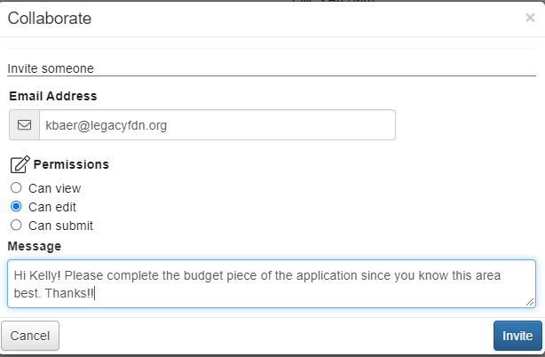
When Two Heads are Better than One…Collaborate!
Complete the pop-up box and click Invite

Slide 35
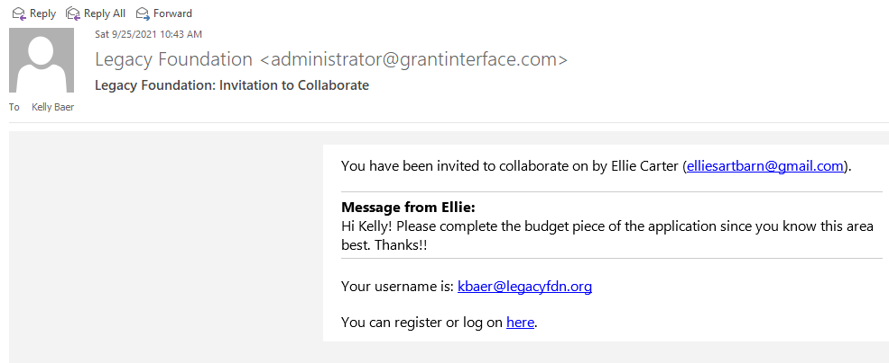
From the Collaborator’s Side…
Your collaborator will receive an email with instructions on how to access the application. Click the link to log on.

Slide 36
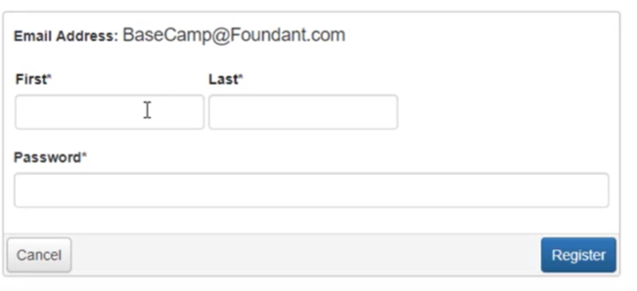
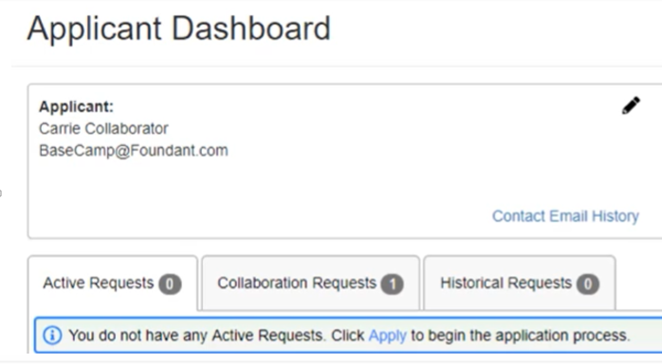
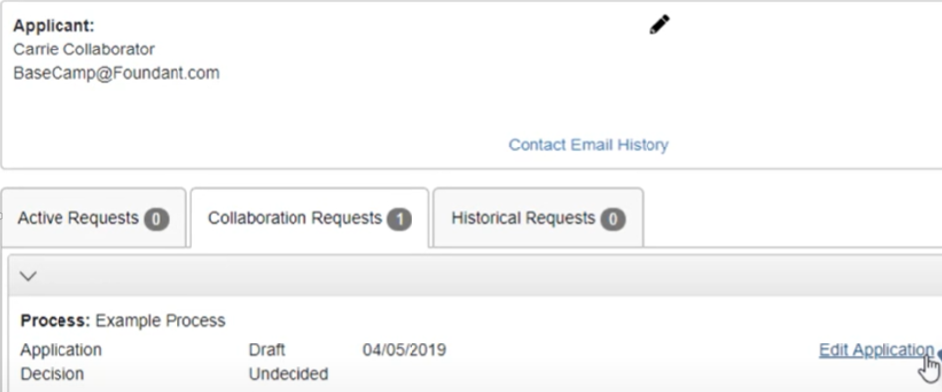
1.
Enter the requested information and click Register
2.
Open the Collaboration Request tab
3.
Edit the application as needed

Slide 37
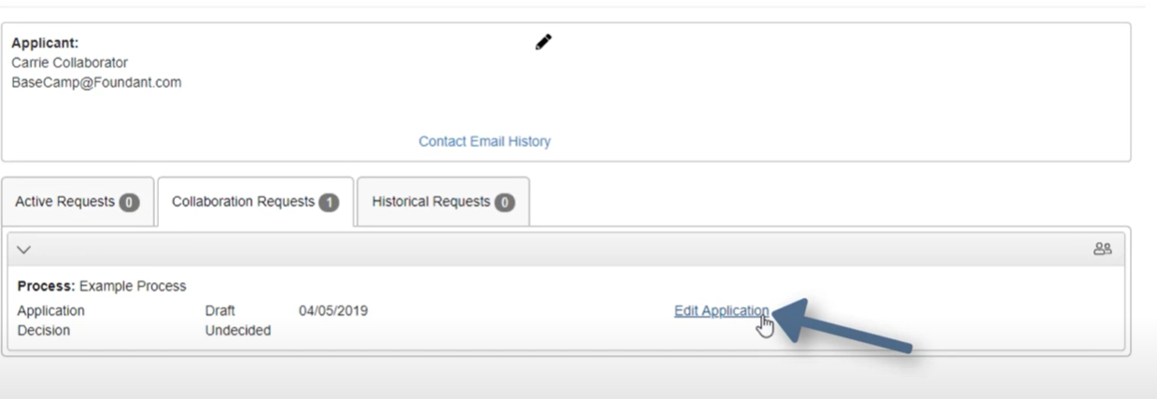

Slide 38
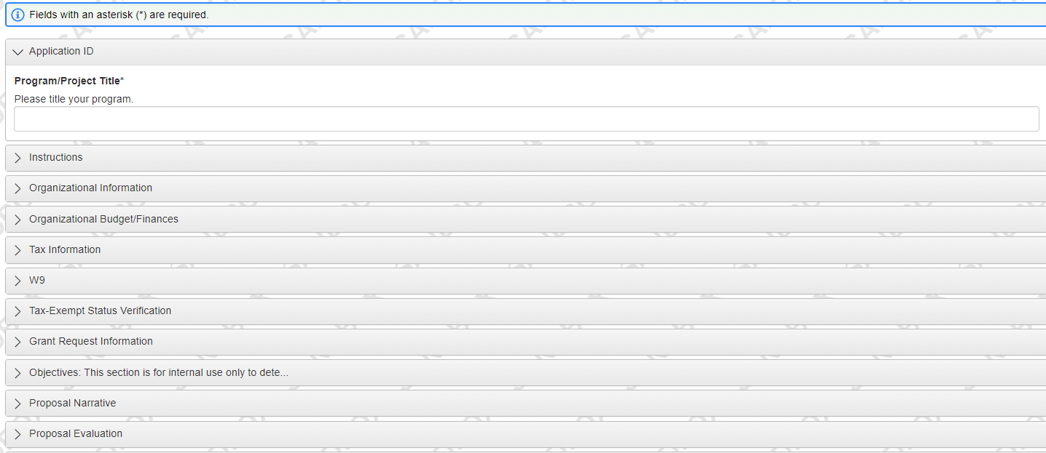
The Application
Open each question section using the >
Based on your responses, a new box may generate.
Continue expanding sections until all questions have been answered.

Slide 39
Ready to Submit?
Legacy Foundation cannot re-open an application after it has been submitted. Please review your application thoroughly.
The software does not have its own review process prior to submitting so we ask you to confirm that you understand our policy and are satisfied with your application
Abandon Request: Use this if (at any time) you no longer intended to submit the application. This will assure you don’t receive automated emails regarding the grant deadline, etc.

Slide 40
Something left to complete?
If you save or try to submit and a required question has not been answered, you will receive a warning message showing what needs finishing.

Slide 41
Post Grant Acceptance

Slide 42
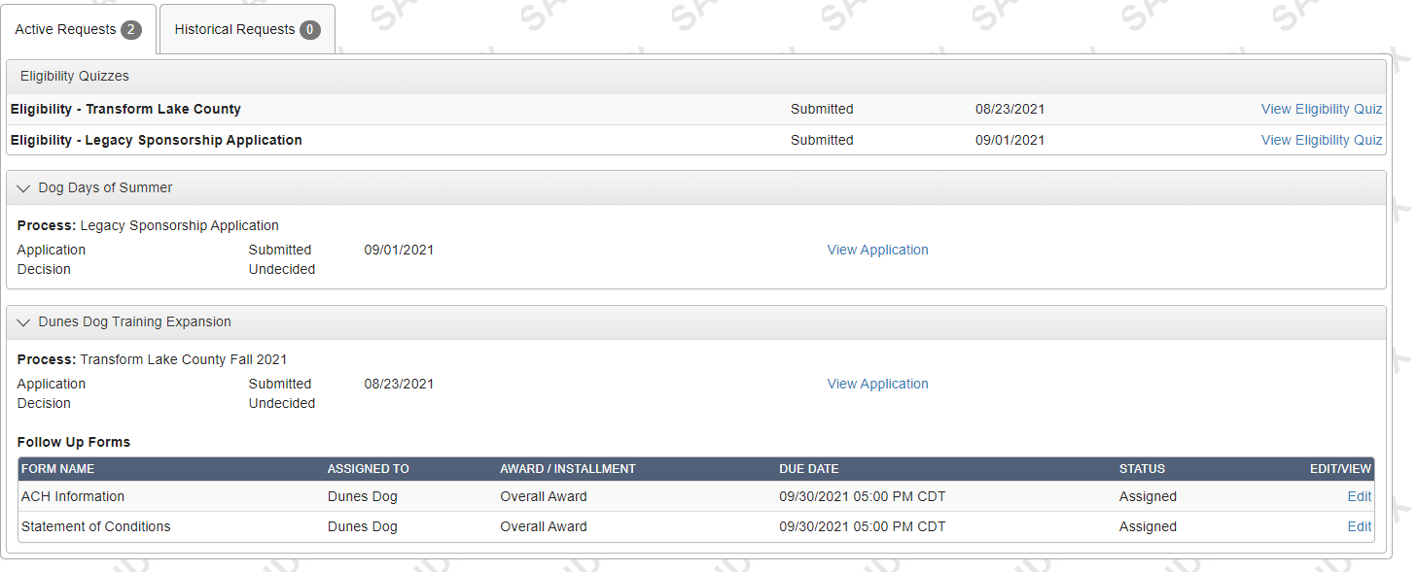
You will receive an email notification that you have received a grant award. Once getting that email, log into your account.
Look for the “Follow Up Forms” section and click to Edit each of the forms you’ve been assigned. Notice due dates are listed for each item.
Funds cannot be released until all Follow Up Forms have been completed.

Slide 43
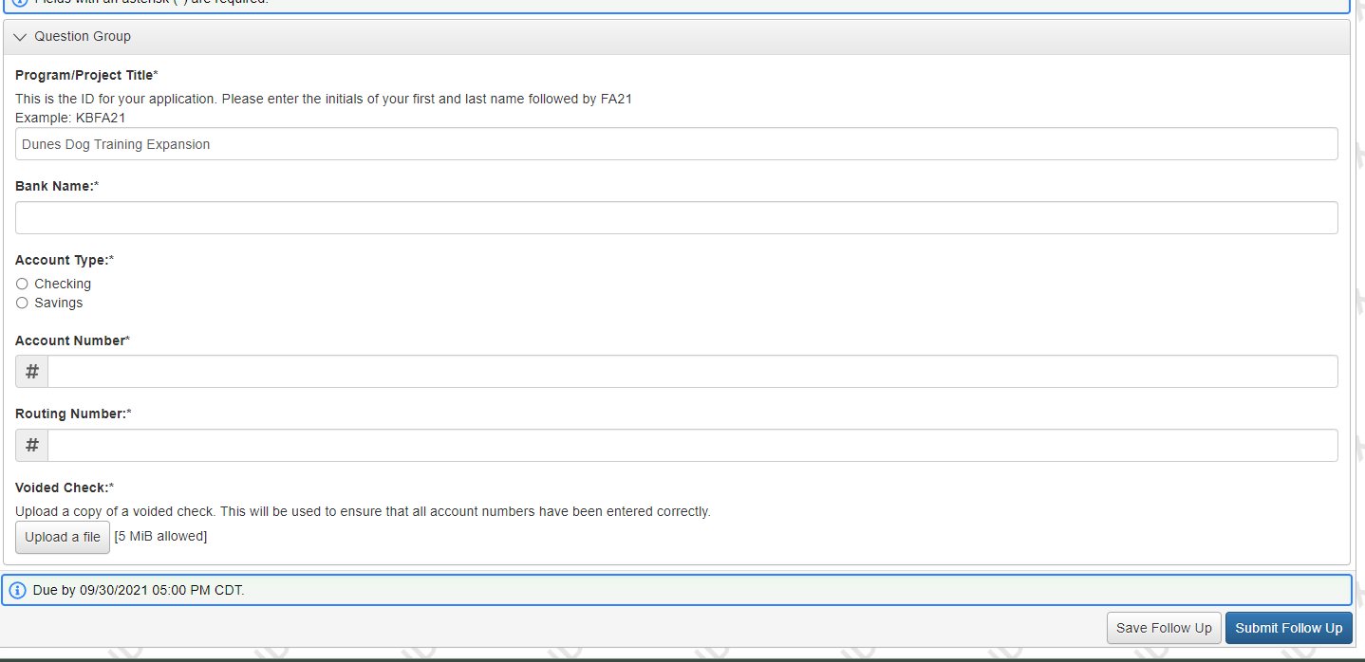
ACH Follow Up Form
Legacy has transitioned to making ACH payments whenever possible. Please complete the requested information.
Legacy requests a copy of a voided check to assure that all account information has been typed in correctly.
If you have not submitted, the system will send an automated email reminder one day before the form’s deadline.

Slide 44
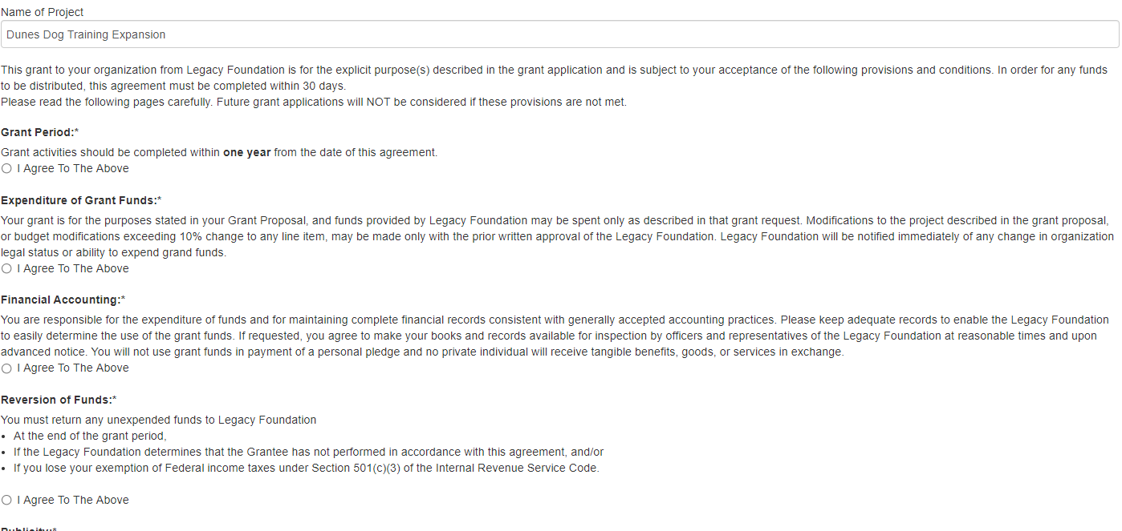
Statement of Conditions Follow Up Form
The Statement of Conditions has moved online! You will need to read through each requirement and agree to the terms as well as to the document as a whole.
You are not required to submit a signed copy of the form to Legacy.
The form can be printed, if needed, by right clicking and choosing Print.
**Payments will NOT be made until both the Statement of Conditions and ACH follow up forms are complete. **
If you have not submitted, the system will send an automated email reminder one day before the form’s deadline.

Slide 45
Grant Monitoring

Slide 46
Due Diligence – All grantees are required to provide due diligence documentation, including financial audits, by-laws, list of Board of Directors or Governing Body, and documentation of 501c3 status.
Site Visits – Legacy staff and/or board will conduct one or more site visits approximately half-way through the grant period. Organizations are encouraged to reach out to Legacy Foundation staff to schedule a site visit during the time project activities are occurring.
Final Reports – At the close of the grant term, grantees are required to submit a final report with financials. Final reports are due exactly 13 months from the date of the submitted SOC. Reports should be submitted online through the grant portal.
Organizations will be ineligible for future funding until the final report is submitted and approved.

Slide 47
Contact Us
Edward Vega
Community Impact Director
evega@legacyfdn.org
Kelly Baer
Grants and Administration Coordinator
kbaer@legacyfdn.org
219-736-1880

