Slide 1

2024 Lilly Endowment Community Scholars Program (LECSP)

Slide 2
  Jodi Kateiva
  Scholarship Administrator
  219-736-1880
  jkateiva@legacyfdn.org

Slide 3

Offers scholarships to Lake County students as motivation to graduate high school and attend college.
Serves as a mentor and resource center to ensure nonprofits can effectively provide services to our community.
Assists donors with planning how to invest and manage their charitable assets.
Collaborates with local leaders to solve problems and enhance residents quality of life.
Provides grants to organizations servicing the Lake County community.

Slide 4
Legacy Foundation’s
Scholarship Program
Two Scholarship Cycles:
Lilly Application Open August 1
Lilly Deadline is September 15
Universal Application (for 40+ various scholarships)
opens November 1
Universal Application due February 1

Slide 5
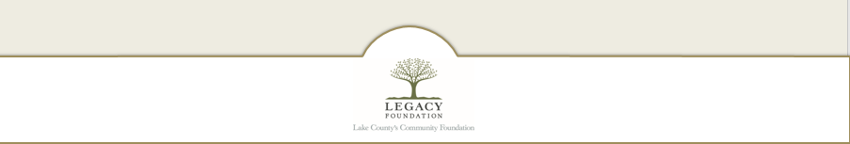
Lilly Endowment Community Scholarship program (LECSP)

Slide 6
What is the LECSP
(aka The Lilly)?
The Lilly Endowment Community Scholarship (LECSP) was established in 1998 to help raise the level of educational attainment in Indiana. LECSP encourages Indiana’s most talented students to attend one of Indiana’s fine colleges or universities and after graduation consider pursuing occupations in Indiana.
Each county in Indiana participates in the LECSP through their local community foundation. Since the program’s inception, Legacy Foundation has been able to award over 200 full tuition scholarships to Lake County students through the LECSP.
Award Details
Six (6) students from Lake county will receive the scholarship.
Covers four (4) years of full tuition to ANY accredited 4-year private or public college in Indiana.
The students will also receive a $900 per year stipend for books.
This NOT a FULL RIDE scholarship. Room & board is NOT covered although most students receive other scholarship awards from their institution to cover at least part of these expenses. Especially Private Schools. Encourage students to apply there even if it a financial reach for them.

Slide 7

Lilly Eligibility Criteria
Must be resident of Lake County
Must be graduating senior from an accredited school in Lake County
3.25 GPA (unweighted) cumulative through Junior Year
Meet Financial Eligibility requirements
Citizenship is NOT required
NO ACT/SAT requirements
Selection Criteria
academics
demonstrated leadership skills
service to others
character
essay
interview

Slide 8
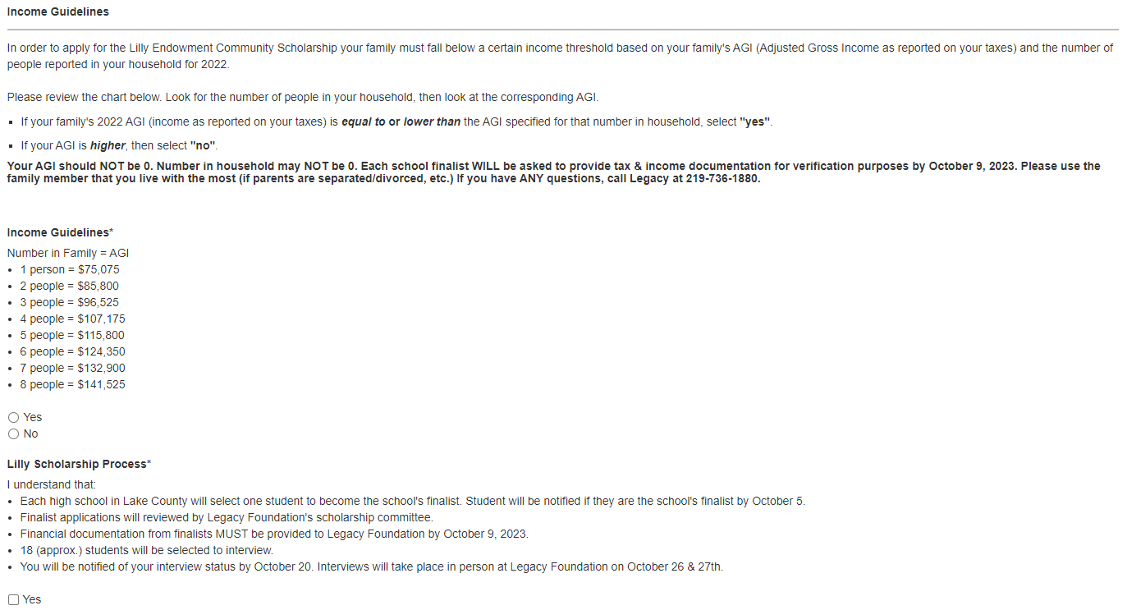
Eligibility Quiz: Financial Requirements
Student’s family must be considered 120% of median income as defined by HUD in order to apply.
To apply for the Lilly Endowment Community Scholarship, your family must fall below a certain income threshold based on your family's AGI (Adjusted Gross Income) and the number of people reported in your household for 2022.
School Finalists will be asked to provide verification of their financial eligibility via tax returns or alternate documentation.

Slide 9
Scoring and Selection Process
Students apply online through Legacy Foundation. September 15
By September 18 at 5pm, Legacy will send each school all their students’ applications. Each school selects one student to become the school's finalist. Each high school has independent autonomy in selecting their finalist.
By October 4, once the school selects their finalist, the school must send Legacy:
  Lilly Report Form
  Transcript & Scholastic Profile (for finalist only)
  Recommendation Profile (for finalist only)
The Legacy selection committee members then read and score all finalist applications. The top scoring finalists will participate in an interview. (approx. 18 students depending on scoring breakdown)
Interviews are scheduled for October 26 & 27 with the Legacy selection committee. Interviews are held from 9am to 5pm.
  Interview lasts approximately 30 minutes.
  Dress is Business Casual.
After the 2 days of interviews, there are 6 recipients and 4 alternates. These must be approved by the Lilly Endowment.
5 additional scholarships will be awarded through this process; they range from $10,000 ($2,500 renewable) to $1000.
Once recipients are confirmed by Lilly Endowment, students & schools will be notified (around Dec 15)

Slide 10
Timeline
September 15, 2023: Online applications must be submitted
September 18, 2023: Completed applications for each school will be emailed as pdf files to guidance office.
October 5, 2023: Lilly High School Report Form due via email to Legacy Foundation by 9AM.
*Scholastic Profile, Recommendation Form & Transcript are due for your Nominee ONLY
Send each form separately; not as one PDF.
October 9 , 2023: Financial Reporting Forms due to Legacy from each school’s nominee.
October 20, 2023: Students & schools will be notified of their interview time & date (if applicable)
TBD: Lilly Overview & Interview Tips Presentation
October 26 - 27, 2023 Student Interviews
Before December 15, 2023 Recipients announced
**The Lilly Endowment develops the timeline for this scholarship, not Legacy Foundation.

Slide 11
Tips for Selecting your Nominee
Mirror our scoring; perhaps a blind initial review process. Many schools interview potential nominees. Non-school review committee.
Remember - we don’t know them; we are just looking at the application. This is key! We often look at a school’s applications and wonder why they “chose” one student over others who seem much more qualified on paper. Everyone at the school may know and love them, but we just see their application.
Interviews seal the deal… encourage them to be honest and open; the more authentic, the better. We encourage schools to do “practice interviews” with finalist.
Emphasis should be on students who “give back” to their community or show passion /dedication to a cause or activity.
Recipients show a passion for Indiana and principals of wanting to stay & thrive here.
The Lilly Scholar Network (for Lilly scholarship recipients) engages in volunteerism, network functions and community engagement activities throughout school and after graduation. We need applicants that WANT to be a part of something like this.

Slide 12
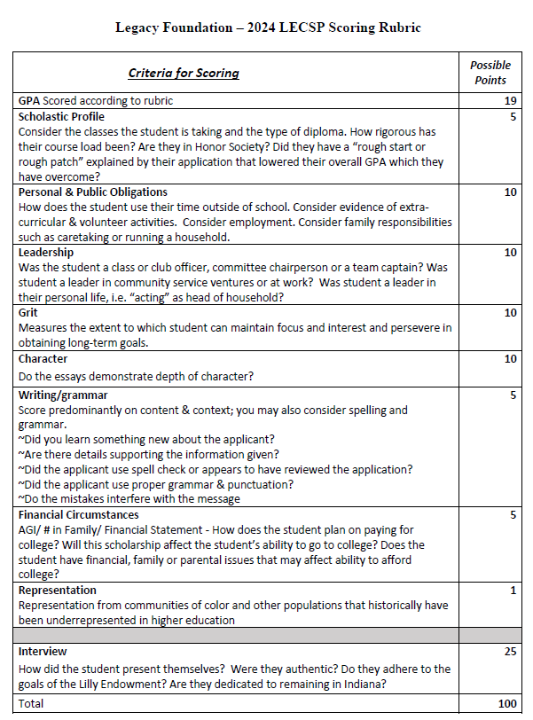

Slide 13
GPA Scoring Grid
Unweighted GPA
GPA | Points
Below 3.25 | 0
3.25 -3.34 | 3
3.35 - 3.44 | 5
3.45 - 3.54 | 10
3.55 - 3.64 | 15
3.65 – 3.84 | 17
3.85 + | 19

Slide 14
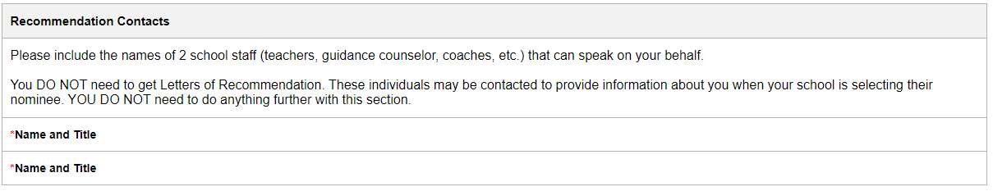
School Nominee Info
What is due via email by October 4th at 9am?
Lilly High School Report Form
Transcript (make sure UNWEIGHTED GPA is on there!)
Scholastic Profile
LECSP Recommendation Form
  This is our version of a recommendation letter. Please take your time when completing; reviewers find this very helpful. Students are asked to include the names of 2 school staff who can provide insight for this part. You can find these names in their application under the Recommendation Contacts. Any school personnel may complete this form.
* Please send each form as it’s own PDF/Document. They must be individually uploaded to the application in different “spots”.

Slide 16
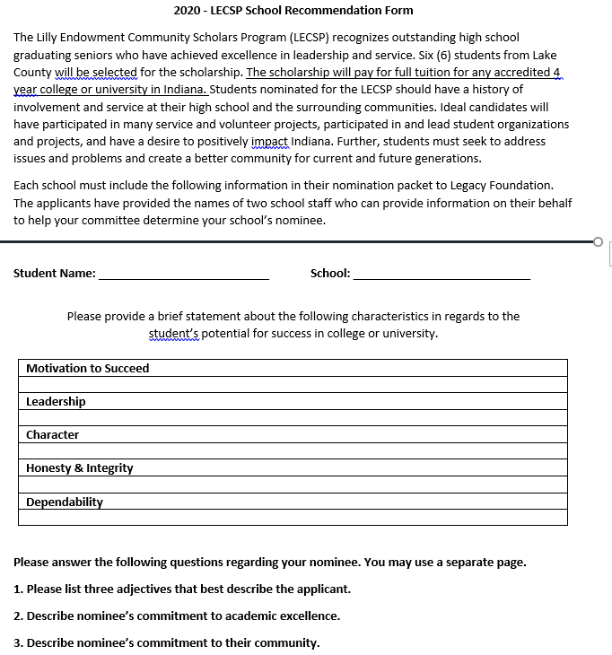
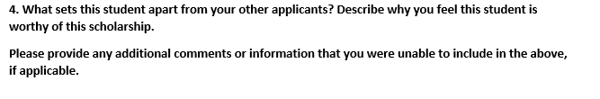
We only need 1 from completed for your nominee.
It can be completed by any school personnel.
Suggestion: Discuss these points with the two people the student listed in the recommendation section and then fill out.
This is an opportunity for you to share things that the student did not put in the application.
Please type these if possible.
These carry weight with reviewers.
The student DOES NOT see the completed form. This is your opportunity to really help your student stand out.

Slide 17
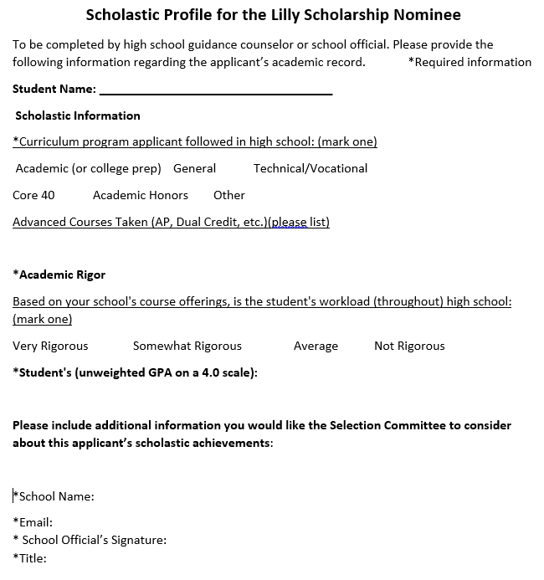

Slide 18
Lilly Scholarship Marketing Material Available
One page flyer
Front-back overview of scholarship
  Briefly covers questions asked in the application – a sneak peak
I will email those today. If you need printed copies, Legacy can mail them to you.

Slide 19


Slide 20
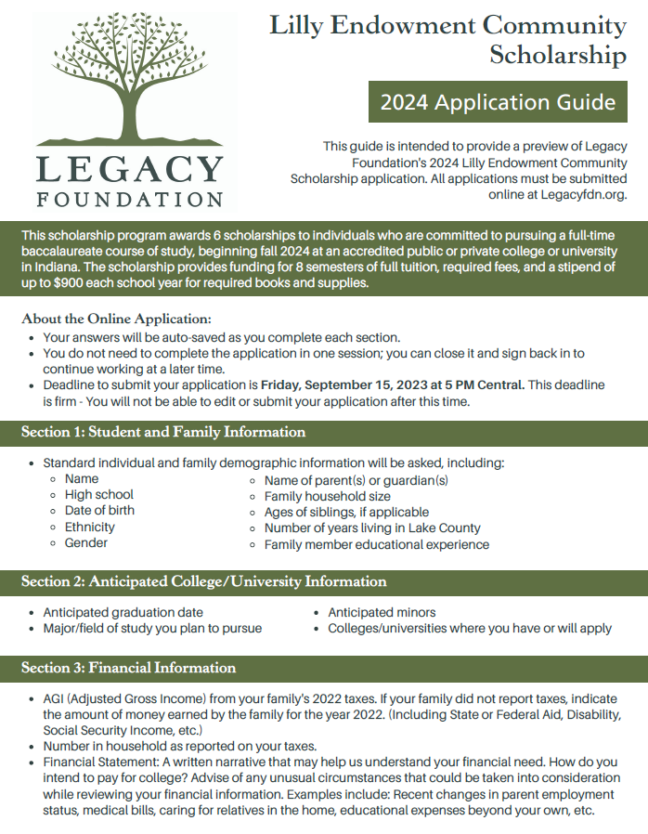

Slide 21
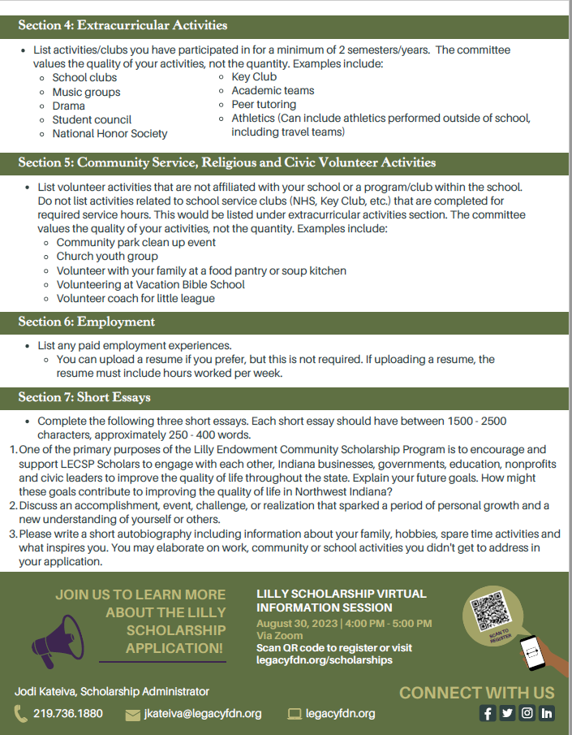

Slide 22
Public Power Point Slides
We will be having a public zoom presentation open to students and parents on August 30 at 4pm.
This gives step by step instructions on how to access & complete the application from a student’s view.
These following slides will be reviewed on our public zoom. The public presentation slides are available on our website now. After the meeting, the recording will be available on the website.

Slide 23
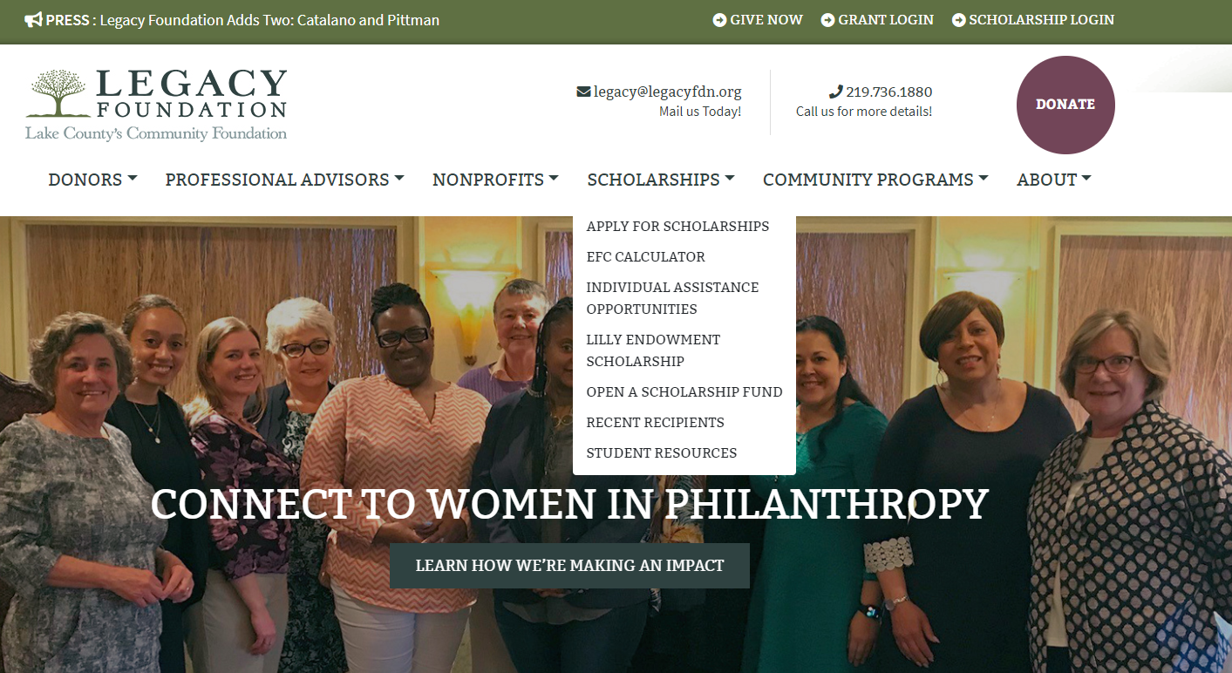
How to apply?
Application is available on our website.
Legacyfdn.org

Slide 24
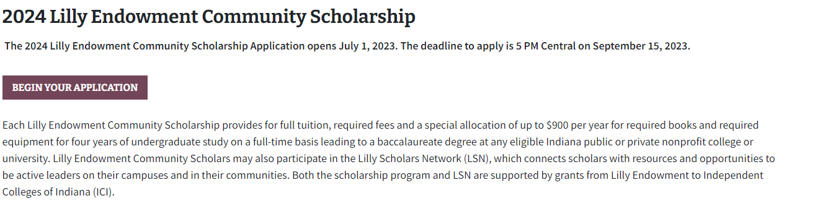
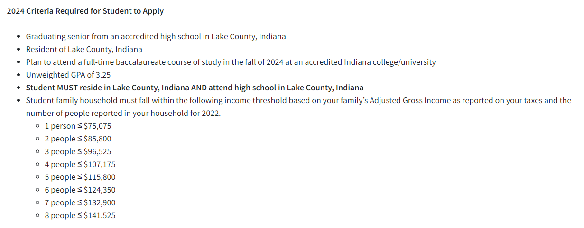

Slide 25
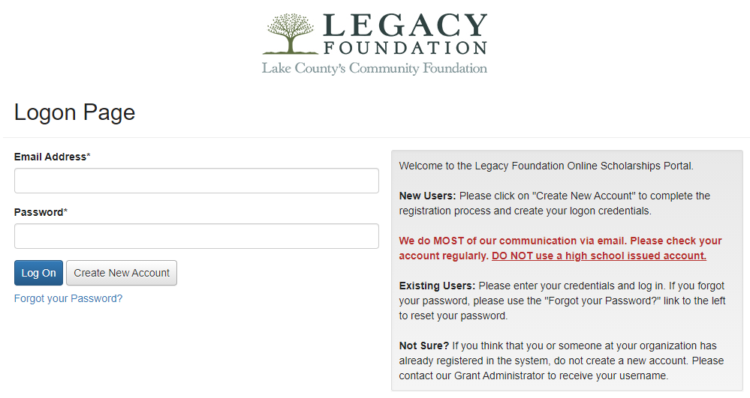
Log In Page
www.grantinterface.com/Home/Logon?urlkey=lfs
DO NOT
use a high school- issued email account!
Students will need to create a new account.
If you forget your password; click here. Check your junk mail if you don’t get something from Foundant. Email Legacy if you are still unable to reset password.

Slide 26
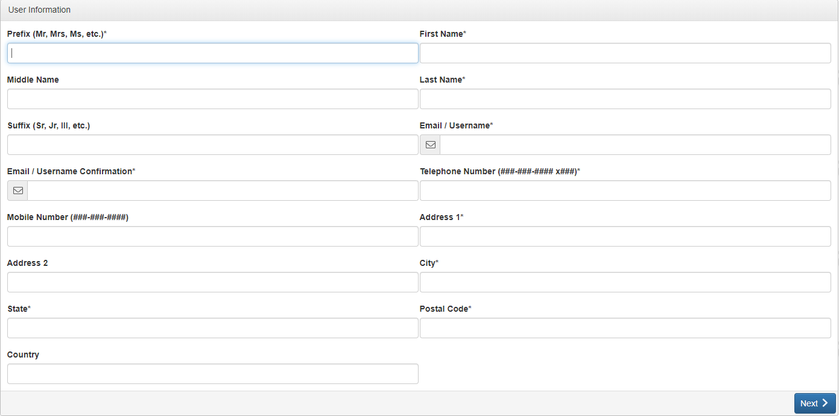
Creating Your Profile
Please note - this is the information that will be attached to all of your future applications. Make sure things are spelled & capitalized correctly.
This should be completed by STUDENTS – NOT PARENTS!

Slide 27
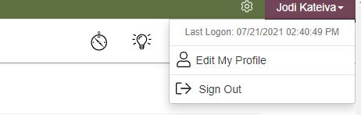
Updating Your Profile
To change / update information on your profile:
Click Your Name in top right corner
Click Edit My Profile
Please make sure this includes the most current contact information for you.

Slide 28
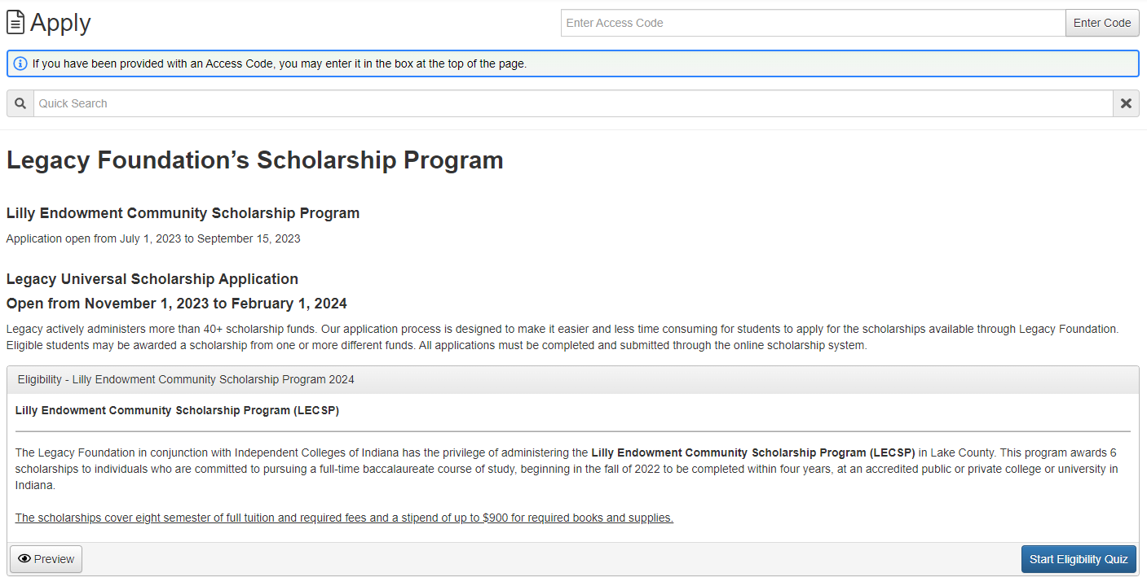
Student Apply Page

Slide 29
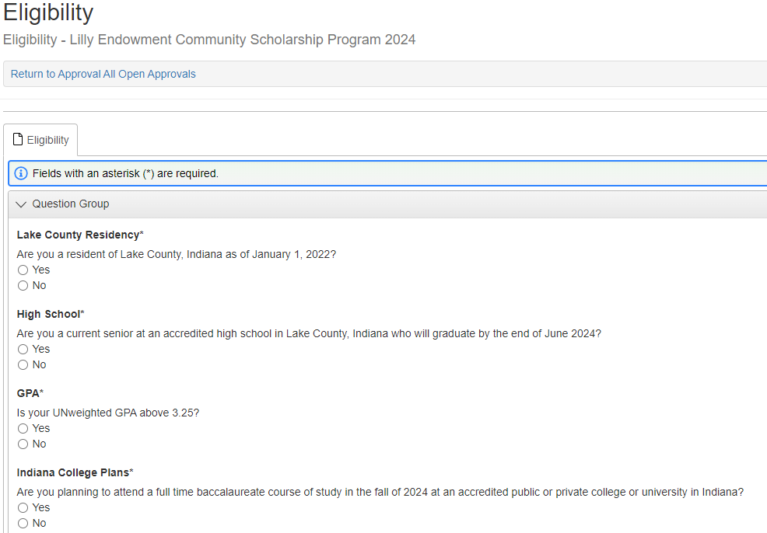
You will first need to complete the Eligibility Quiz
Eligibility Quiz

Slide 30
Eligibility Quiz: Financial Requirements
Student’s family must be considered 120% of median income as defined by HUD in order to apply.
In order to apply for the Lilly Endowment Community Scholarship your family must fall below a certain income threshold based on your family's AGI (Adjusted Gross Income)
and the number of people reported in your household for 2022.
School Finalists will be asked to provide verification of their financial eligibility via tax returns or alternate documentation.

Slide 31
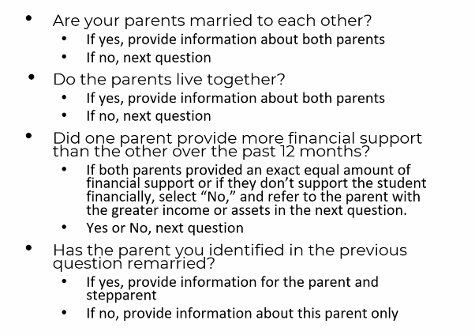
Which parent’s info do I use?
What if I am emancipated or a ward of the state?
You would use your sole income (if any)

Slide 32
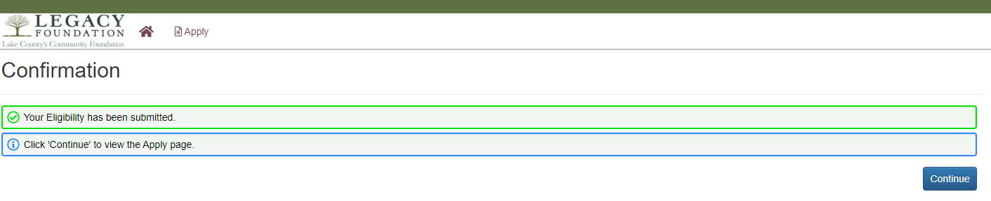
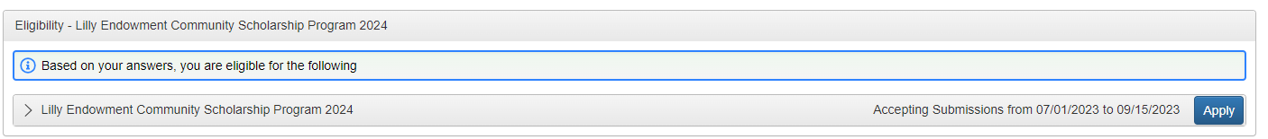
If you are eligible, click the “Apply” button to access application.
If you are not eligible and have questions, please reach out.

Slide 33
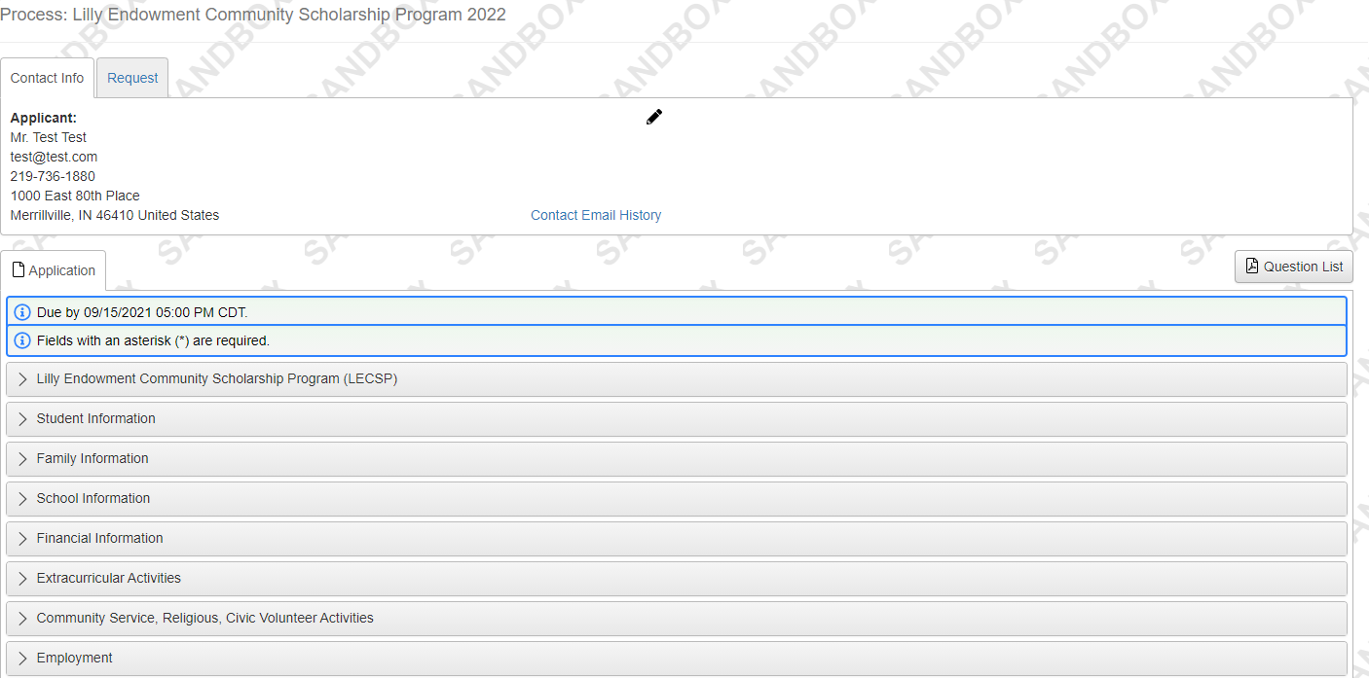
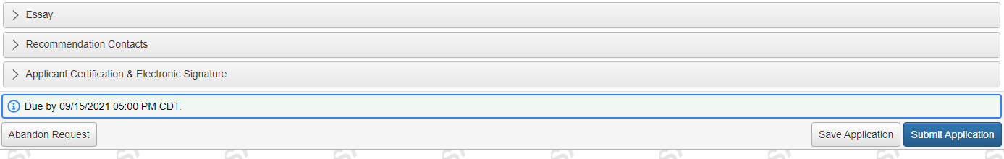
Student View: Application
You can download a PDF
of the application.
Students can expand/close each of the sections.

Slide 34
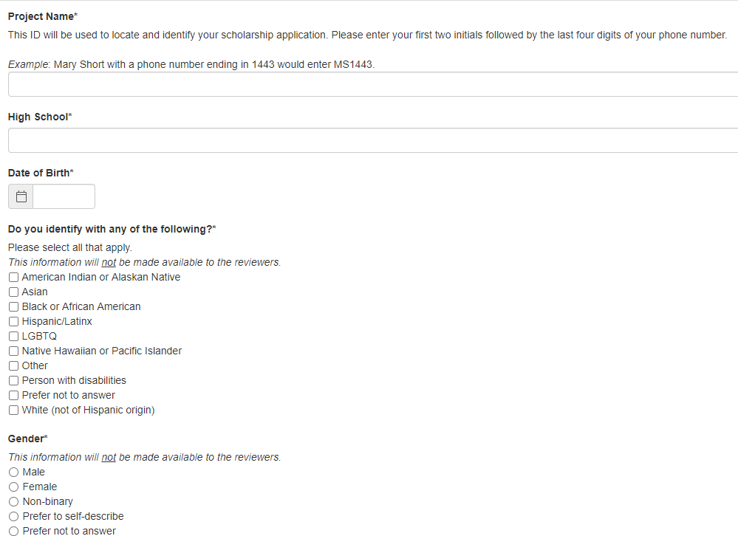
Student View: Student Information
We ask these questions for tracking purposes only.
We want to ensure that we are reaching a diverse community of students reflective of
Lake County.

Slide 35
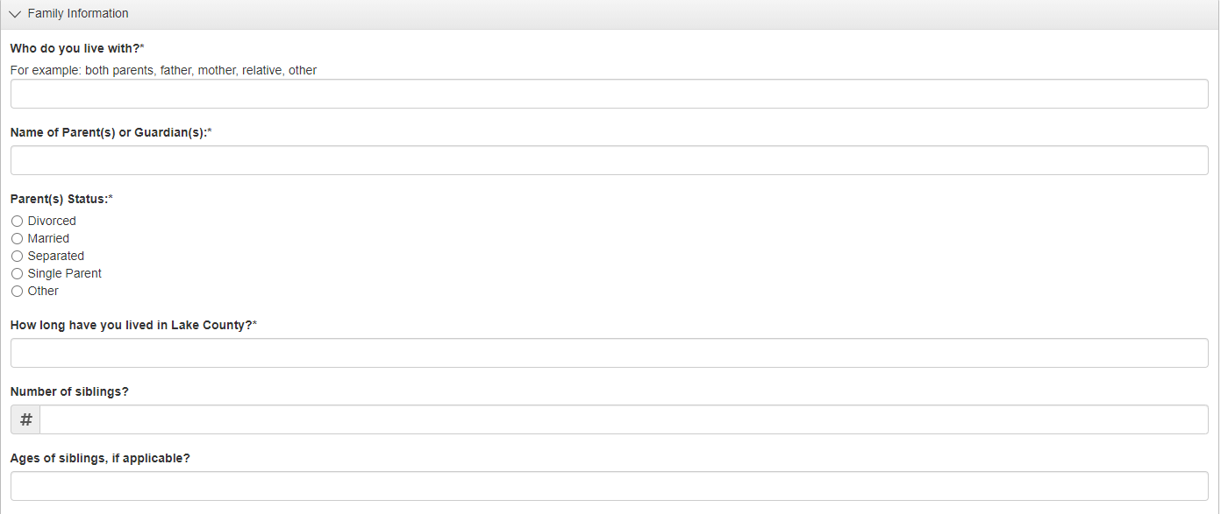
Student View: Family Information

Slide 36
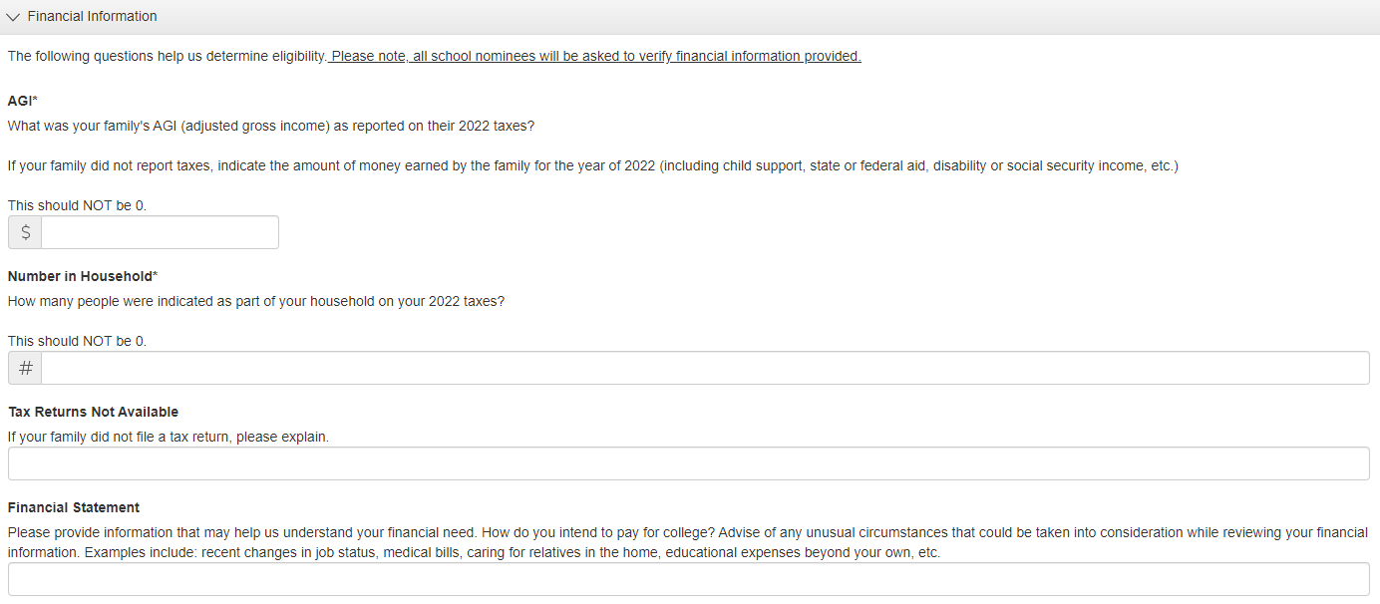
Student View: Financial Information

Slide 37
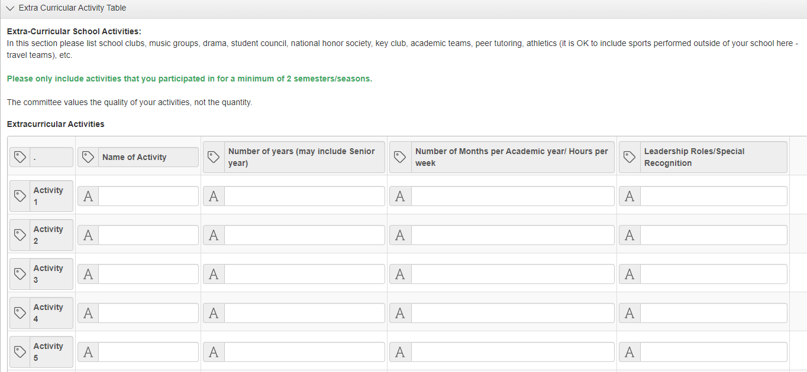
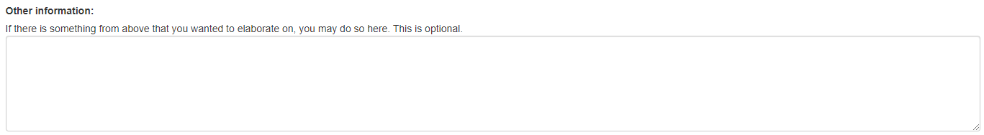
Student View: Extra Curricular Activities

Slide 38
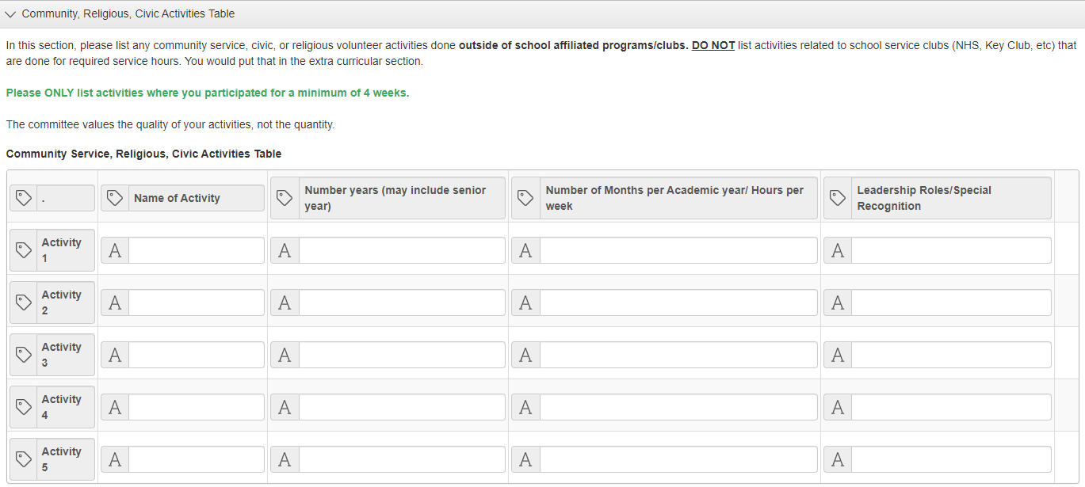
Student View: Community, Religious, Civic Activities
Key Points:
Follow the example format.
DO NOT list activities related to school service clubs (NHS, Key Club, etc.) that are done for required service hours. You would put that in the extra curricular section.
Please ONLY list activities where you participated for a minimum of 4 weeks.

Slide 39
Student View: Essay
You will need to complete 3 essays.
Each essay is limited to 2,500 characters or 250-400 words.
We recommend saving them in another format and copying them into the essay boxes.
Essay 1
One of the primary purposes of the Lilly Endowment Community Scholarship Program is to encourage and support LECSP Scholars to engage with each other, Indiana businesses, governments, education, nonprofits and civic leaders to improve the quality of life throughout the state. Explain your future goals. How might these goals contribute to improving the quality of life in Northwest Indiana?
Essay 2
Please write a short autobiography including information about your family, hobbies, spare time activities and what inspires you. You may elaborate on work, community or school activities you didn't get to address in your application.
Essay 3
Discuss an accomplishment, event, challenge, or realization that sparked a period of personal growth and a new understanding of yourself or others.

Slide 40
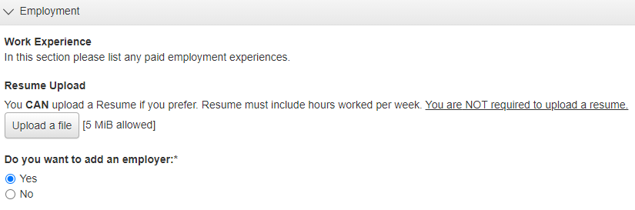
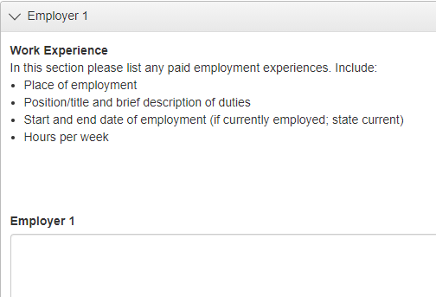
Student View: Employment History
Key Point:
You can upload a resume instead of typing in each employer. If you chose this option, make sure it contains the necessary information.
It is NOT required that you upload a resume. We do NOT want you to create one just for this process. This is a timesaver for those of you that have them!

Slide 41
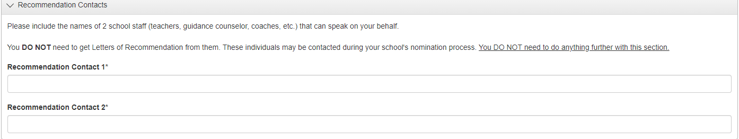
Student View: Recommendation Contacts
Students DO NOT need to get Recommendation Letters for this application.
This section allows the student to name 2 contacts that the school can use to gather information when selecting their nominee.

Slide 42
Student View: Essay
You will need to complete 3 essays.
Each essay is limited to 2,500 characters or 250-400 words.
We recommend saving them in another form and copying them into the essay boxes.
Essay 1
One of the primary purposes of the Lilly Endowment Community Scholarship Program is to encourage and support LECSP Scholars to engage with each other, Indiana businesses, governments, education, nonprofits and civic leaders to improve the quality of life throughout the state. Explain your future goals. How might these goals contribute to improving the quality of life in Northwest Indiana?
Essay 2
Help us get to know you. Write about your background, identity, an interest, or talent that is meaningful to you.
Essay 3
Discuss an accomplishment, event, challenge, or realization that sparked a period of personal growth and a new understanding of yourself or others.

Slide 43


Slide 44

Scholarship Tips
Brag about yourself!
Take time to write down all of your activities, goals, and what sets you apart. This can be used for college applications & all of the scholarships you will apply for.
Capitalization & spelling counts.
Print it and read it aloud before you submit. This will help you hear errors that you don’t always see.
Make sure uploaded documents are correct.
Find a reviewer. They catch things you might miss.
Take your time.
Do not wait until the last minute to complete or submit! Computers have glitches. Don’t let a computer issue ruin your day- or your chances of getting this awesome scholarship!
The DEADLINE is 5pm. Not 5:02, 5:05 or 5:10.

Slide 45

Questions?

